Slide 1
Teaching an AI to schedule cancer drugs
AI IN MEDICINE · COURSE PROJECT
Every experiment we ran: what we did, what we saw, and what it means
30 experiments · 585 trained AI agents · explained in plain language
Notes:
This deck walks through every experiment in the project. Each experiment gets three slides: how we did it, the graphs and numbers, and what we found in at most four points. An introduction comes first and an overall conclusion at the end.

Slide 2



Why cancer drugs stop working
INTRODUCTION
1. A tumour is a mix
2. Full dose kills the blue
3. The orange take over
Most cells are drug-sensitive (blue). A few are resistant (orange).
The tumour shrinks, so at first the treatment looks like it works.
With no competitors left, resistant cells regrow and the drug stops working.
In our virtual patient, giving the full dose all the time fails after 452 days.
Notes:
The core problem is evolution inside the tumour. Hitting it as hard as possible removes the very cells that were keeping the resistant ones in check. This is called competitive release.

Slide 3
Adaptive therapy: treat less to stay in control
INTRODUCTION
1
Sensitive and resistant cells compete for the same space and food.
THE BIG IDEA
Keep some sensitive cells alive on purpose, so they hold the resistant cells back.
2
Give the drug when the tumour gets too big; pause when it is under control.
3
A prostate-cancer trial used a simple rule called AT50: treat until the tumour halves, then pause until it is back (Zhang 2017).
4
Open question: exactly when should we treat? That is where AI comes in.
Notes:
Adaptive therapy was proposed by Gatenby in 2009. Its goal is to contain the tumour rather than to cure it. Human rules like AT50 are easy to follow but are probably not the best possible schedule, which is why researchers have started using reinforcement learning to find better ones.

Slide 4
How an AI learns a treatment schedule
INTRODUCTION
1. Look
2. Decide
3. Get a reward
The AI sees the tumour this week
Drug on or off for the next week
The simulator moves a week ahead and scores the result
Repeat about a million times and the AI learns which choices earn the most reward. This is called reinforcement learning.
The reward is the goal. Change it and the AI learns something different.
10 copies per goal. We train ten separate AIs to make sure results are not luck.
Notes:
The learning method we used is called PPO (proximal policy optimisation). We wrote it ourselves rather than using a library. Each AI is a small neural network. The ten copies are called seeds: same settings, different random start. If the ten agree, a result is real; if they disagree, it might be luck.

Slide 5
Which goal should the AI be given?
INTRODUCTION · OUR QUESTION
Goal | In plain words | Taken from
R1 Survival | Stay alive longer; small bonus for drug-free weeks | Gallagher 2023
R2 Less drug | Use as little drug as possible, for as short a time as possible | Gluzman 2020
R3 Keep the mix | Keep sensitive and resistant cells in a balanced mix | Giles & Newton 2026
R4 Lasting control | Leave a tumour that stays mostly sensitive, even after a long drug break | Yao 2024
Each paper used a different goal and a different simulator. We put all four in one simulator, so only the goal changes.
Notes:
This is the question the whole project answers: does the goal change what the AI learns, and what do you lose if you pick the wrong goal? We use the labels R1 to R4 throughout the deck.

Slide 6
Our virtual patient
INTRODUCTION · THE SIMULATOR
1
Two groups of cells grow and compete for the same space (a standard model by Strobl, 2021).
THE MAIN PATIENT
2
The drug kills sensitive cells that are dividing. Resistant cells ignore it.
Start: 99.9% sensitive, 0.1% resistant
Failure line: 1.2 × starting size
3
Every week, a decision: drug on or drug off.
Resistant cells: grow as fast as sensitive ones
4
Treatment has failed once the tumour is 20% bigger than at the start.
Source: the same patient as Gallagher et al. 2023
Notes:
This is called the proof-of-principle patient in the source paper. Later experiments change it: resistant cells that grow slower (a cost of resistance), cells that die naturally over time (turnover), a different drug, and so on. Everything is a computer simulation; no real patient data was used.

Slide 7
Six words used on almost every slide
INTRODUCTION · KEY WORDS
Word | What it means here
Time to failure (TTP) | Days until the tumour passes the failure line. Longer is better.
Best possible plan | Worked out exactly by a computer that knows the model (value iteration). Our ceiling.
Score | 0 = no better than no treatment; 1 = as good as the best possible plan.
AI agent | A program trained by trial and error. Below 0.7 on its own goal, we say it “did not train”.
Human rule | A fixed schedule: full dose always (MTD), AT50, AT90, or a tuned rule (AT-PSC).
Containment | Keep the tumour just below the failure line; give drug only when needed.
Notes:
Two more terms appear later. A “cross-evaluation” scores every strategy on every goal, not only the one it was trained for. “Policy” just means the AI’s strategy: which dose it picks in each situation. TTP stands for time to progression, the standard clinical term.

Slide 8
30 experiments in five parts
INTRODUCTION · ROADMAP
1 · Check
2 · Compare
3 · Stress test
4 · What AI sees
5 · Follow-ups
E0 match the paper
E3 train the AI
E6 mix target
E11 size only
A1–A3 fairness checks
E1 human rules
E4 score on every goal
E7 new patients
E11b better teacher
B1–B4 extra analyses
E2 best possible plan
E5 do strategies differ?
E8 wrong numbers
E11c memory
C1 patient map
E9 fewer check-ups
E11d longer training
D1–D4 dose levels
E10 other drugs
FE1–FE2 biology
E3c slower resistant cells
Notes:
Parts 1 to 4 were the first round of work (315 trained agents). Part 5 is a second round of 14 follow-up experiments (270 more agents) that answer questions a reviewer would ask. In the follow-up round, FE1 and FE2 are the project’s “E1” and “E2” follow-ups, renamed here so they are not confused with the first-round E1 and E2.

Slide 9
Building and checking the simulator
PART 1 · E0, E1, E2
Does our virtual patient behave like the published one? How good are human rules, and what is the best possible plan?

Slide 10
Does our simulator match the published study?
E0 · METHOD
1
We built the simulator from the equations and patient numbers in Gallagher et al. 2023.
THE QUESTION
Before trusting any result, does our virtual patient behave like the one in the paper?
2
We ran the two schedules the paper reports: full dose all the time, and AT50.
3
We compared the days until failure with the paper’s numbers.
4
We checked our maths against a slower, high-precision solver.
Notes:
E0 is the foundation: if the simulator were wrong, every later number would be wrong too. We used daily decisions here because that is what the paper used for this figure.

Slide 11
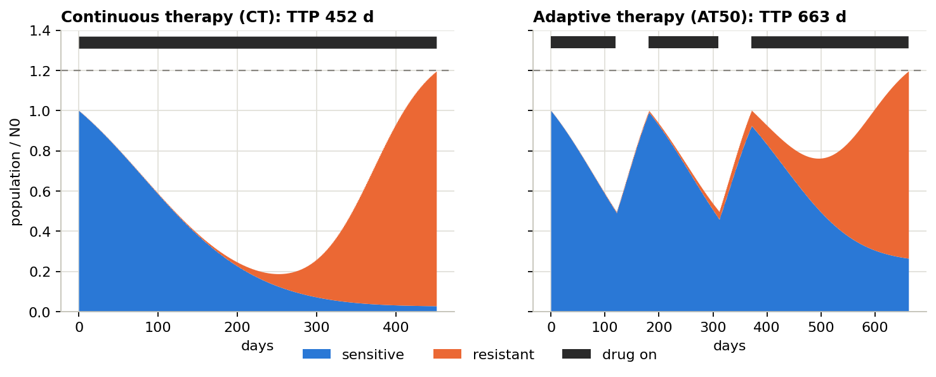
Both schedules match the paper
E0 · RESULTS
How to read it: blue = sensitive cells, orange = resistant cells, black bars = drug on, dashed line = failure. Full dose fails at day 452 (paper: 450–451); AT50 at day 663 (paper: 662).
Notes:
Left: full dose kills the sensitive cells fast, then resistant cells take over and the tumour crosses the line at day 452. Right: AT50 pauses whenever the tumour halves, so sensitive cells regrow and keep competing; failure comes at day 663. The paper also quotes 672 days in one table; we reproduce exactly 672 with monthly check-ups, so that number was most likely a monthly-cadence result.

Slide 12
Our simulator is a faithful copy
E0 · WHAT WE FOUND
1
It matches. Full dose fails at 452 days and AT50 at 663 days, the same as the paper.
2
Pausing works. AT50’s drug breaks let sensitive cells regrow and buy about 210 extra days.
3
One number in our plan was wrong. The starting share of resistant cells is 0.1%, not 1%; with 1% nothing matched.
4
The maths is accurate. It agrees with a high-precision solver to within 0.01 days.
Notes:
We found the correct 0.1% in the authors’ own code. With the 1% from our original plan, full dose failed at 369 days and AT50 at 473, which matched nothing in the paper.

Slide 13
How good are simple human rules?
E1 · METHOD
1
We tested 8 fixed rules, from “no treatment” and “full dose always” to on/off cycles.
THE QUESTION
How long do common rules last, and how much room is left for something better?
2
AT-x: treat until the tumour falls to x% of its start, then pause until it is back.
3
We tuned a cycle rule (AT-PSC) to give it its best chance on this patient.
4
We repeated this over a map of many patients and compared with the best possible plan.
Notes:
The patient map varies two things: how much slower resistant cells grow (cost of resistance) and how fast all cells die naturally (turnover). Strobl 2021 showed both help adaptive therapy. Above a certain line, patients never fail at all, so we stay below it.

Slide 14
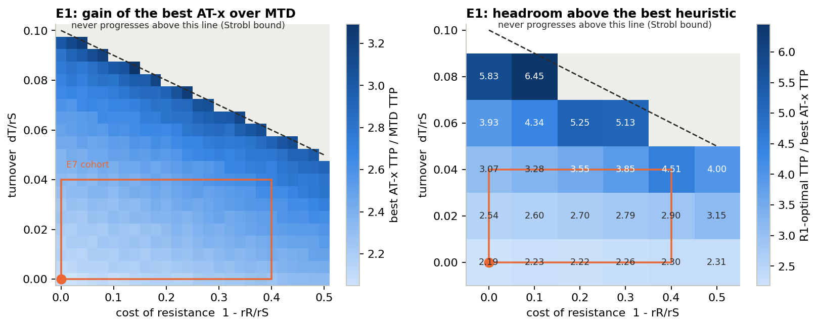
Pausing helps, and tuning helps more
E1 · RESULTS
Rule | Days
No treatment | 41
On/off cycles (IT) | 167
Full dose (MTD) | 452
AT25 | 588
AT50 | 673
AT75 | 798
AT90 | 932
AT-PSC, tuned | 1135
Best possible plan | 2038
How to read the maps: each square is a different patient; the orange dot is ours. Left: best AT rule ÷ full dose (2–3.3×). Right: best possible plan ÷ best AT rule (2.2–6.5×).
Notes:
The table is our main patient with weekly decisions. AT90 means pausing as soon as the tumour drops 10%, which keeps more sensitive cells and works better than AT50. The published AT-PSC rule (treat 13 of every 30 days) fails here at 80 days, so we tuned it; its best version simply treats whenever the tumour is above its starting size.

Slide 15
Human rules help, but leave a lot of room
E1 · WHAT WE FOUND
1
Pausing beats full dose everywhere: 2–3.3× longer across all patients.
2
Treating less is better: pausing early (AT90, 932 days) beats AT50 (673 days).
3
The best human rule lasts 1135 days. Tuned, it becomes “treat whenever the tumour is above its starting size”.
4
The best possible plan reaches 2038 days, so there is a lot of room for a smarter schedule.
Notes:
These rules are the bar the AI has to beat. The best rule that a clinician could follow already almost doubles AT50, but the exact optimum is almost double again.

Slide 16
What is the best possible plan for each goal?
E2 · METHOD
1
We cut every possible tumour state into a grid of 161 × 241 squares (size × share of resistant cells).
THE QUESTION
If a computer knows the patient perfectly, what is the best schedule for each goal?
2
For every square, a method called value iteration works out the best choice: treat or wait.
3
We did this separately for each goal, using the same simulator.
4
Each result is that goal’s ceiling: the “1.0” on our score scale.
Notes:
Value iteration is not learning by trial and error; it is exact planning that needs a perfect model of the patient. A real clinic never has that, which is why we also train AI agents. But the planner tells us how far the agents are from perfect.

Slide 17
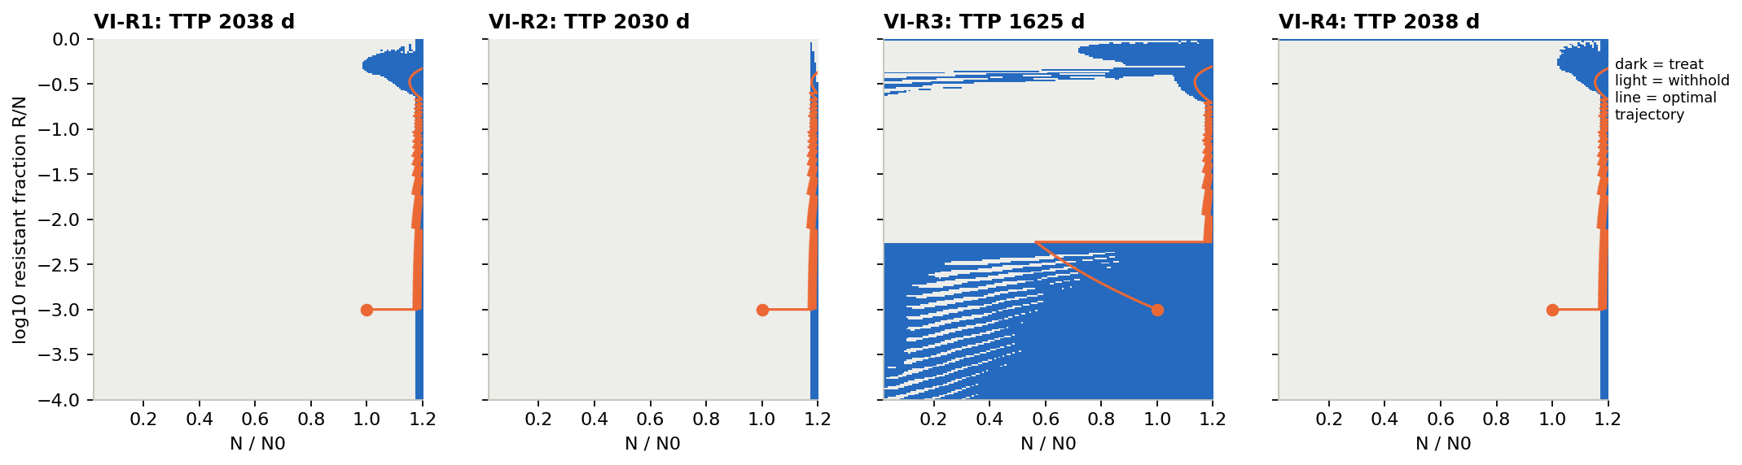
Three goals pick the same plan; R3 does not
E2 · RESULTS
How to read it: across = tumour size (1.2 is the failure line), up = share of resistant cells. Dark = treat, light = wait. The orange line is the path the tumour actually takes.
Days to failure: R1 2038 · R2 2030 · R3 1625 · R4 2038.
Notes:
For R1, R2 and R4 the dark region is a thin strip just left of 1.2: wait while the tumour regrows, and treat only when the next week would cross the line. For R3 there is also a big dark area at the bottom, where resistant cells are rare: the plan treats early to make the mix more balanced, because its reward punishes a nearly pure tumour. The planner’s numbers match a full simulation to within 1%.

Slide 18
The best plan is “containment”
E2 · WHAT WE FOUND
1
R1, R2 and R4 agree: let the tumour regrow, and treat only when next week would cross the failure line.
2
It lasts about 2030–2038 days, 1.8× the best human rule.
3
R3 is the odd one out. It treats early to balance the mix and fails about 400 days sooner.
4
These plans are our yardstick: every AI is scored against them.
Notes:
Containment keeps as many sensitive cells as the failure line allows. Those cells are the competitors that slow the resistant ones down, which is why it wins for survival, for drug use and for lasting control at the same time.

Slide 19
Training the AI and comparing the goals
PART 2 · E3, E4, E5
Can the AI learn each goal? Does the goal change what it learns, and what does the wrong goal cost?

Slide 20
Can the AI learn each of the four goals?
E3 · METHOD
1
We trained 10 AIs per goal: 40 in total.
THE QUESTION
With identical settings, does the AI learn a good schedule for every goal?
2
Every AI got the same network, the same settings and 1 million practice steps.
3
Only the reward, the goal, was different.
4
We tracked survival during practice and scored each final AI against its goal’s best plan.
Notes:
A practice step is one weekly decision in the simulator. One million steps is several thousand simulated patients. In this experiment the AI sees the full picture: tumour size and how many cells are sensitive or resistant. Later experiments take that away.

Slide 21
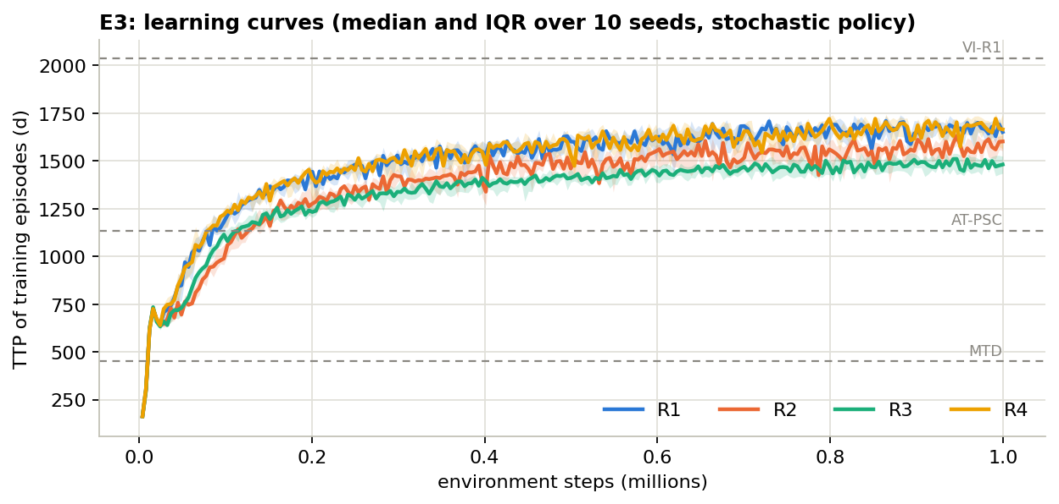
All 40 AIs learned; R3 learned the least
E3 · RESULTS
Goal | Score | Trained
R1 | 0.87 | 10/10
R2 | 0.85 | 10/10
R3 | 0.76 | 10/10
R4 | 0.87 | 10/10
How to read it: each line is the middle of 10 AIs; higher = the patient survived longer in practice. Dashed lines: full dose, best human rule, best possible plan. Score = each AI on its own goal.
Notes:
The shaded bands around each line show the spread across the ten AIs; they are narrow, so training is stable. During practice the AI still makes some random choices, so these curves sit a little below the final numbers.

Slide 22
The AI learns every goal and beats every human rule
E3 · WHAT WE FOUND
1
All 40 AIs trained. None fell below our 0.7 bar.
2
They reach 85–87% of the best plan for R1, R2 and R4, and 76% for R3.
3
Early on they pass the best human rule (1135 days), within about 150,000 practice steps.
4
R3 is the hardest to learn: its reward mostly comes from delaying one big penalty far in the future.
Notes:
We chose the training length and one learning setting on small pilot runs, and changed them for all four goals at once so the comparison stays fair. R1 was unaffected by that change; R3 improved the most.

Slide 23
Score every strategy on every goal
E4 · METHOD
1
We took the 40 trained AIs, the 4 best plans and 4 human rules.
THE QUESTION
Does training on one goal hurt the others? What does the wrong goal cost?
2
Each one treated the same virtual patient.
3
We scored every strategy on all four goals, not only its own.
4
We compared days to failure across goals with statistical tests over the 10 copies.
Notes:
This is the core experiment of the project. Scoring an AI on goals it was not trained for is what reveals the cost of choosing the wrong goal. Our plan also tested a specific hypothesis: that an AI trained to keep the mix (R3) would end up outlasting one trained to survive (R1).

Slide 24
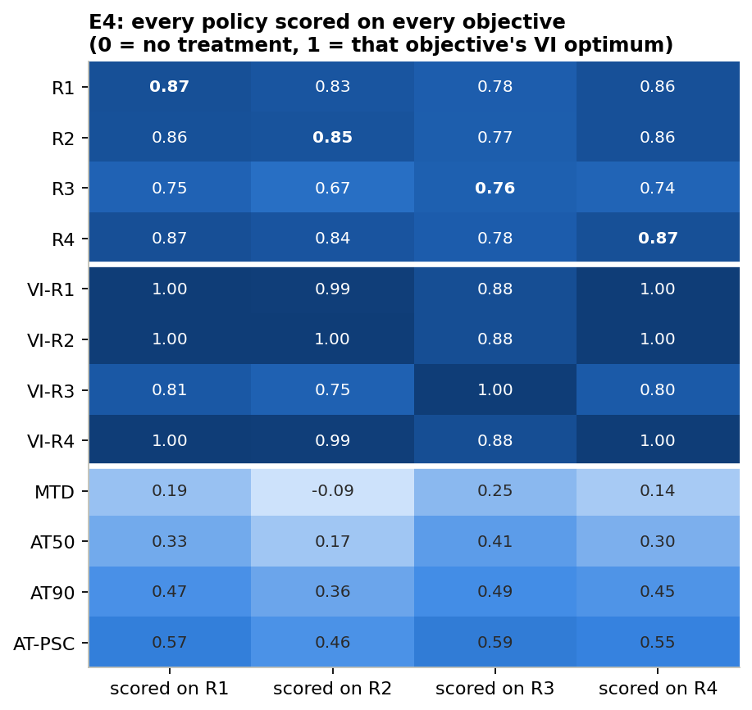
Training on R3 costs points everywhere else
E4 · RESULTS (1 OF 3)
Rows = who is scored. Columns = the goal used to score them.
1.0 = as good as the best plan for that goal; 0 = like no treatment.
Bold = each AI on its own goal.
Read across the R3 row: 0.67–0.75 on the other goals, against 0.83–0.87 for the rest.
Notes:
Each AI row is the median of ten trained copies. The bottom four rows are human rules: even the best one (AT-PSC) scores only 0.46 to 0.59, so every trained AI beats every rule on every goal. The best plans score 1.0 on their own goal and 0.88 to 1.0 on the others, except the R3 plan, which drops to 0.75 to 0.81.

Slide 25
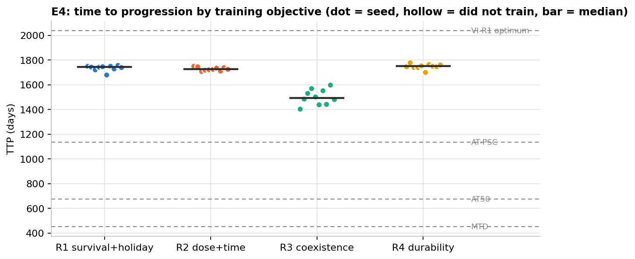
R1, R2 and R4 last as long; R3 fails sooner
E4 · RESULTS (2 OF 3)
How to read it: each dot is one AI; the bar is the middle value. Middles: R1 1744 · R2 1726 · R3 1494 · R4 1751 days. Dashed lines: best plan, best human rule, AT50, full dose.
Notes:
The difference between goals is statistically clear (Kruskal–Wallis p = 0.00001). R1, R2 and R4 are not different from each other after correcting for multiple comparisons; R3 is about 250 days shorter. R3’s AIs also vary more from copy to copy.

Slide 26
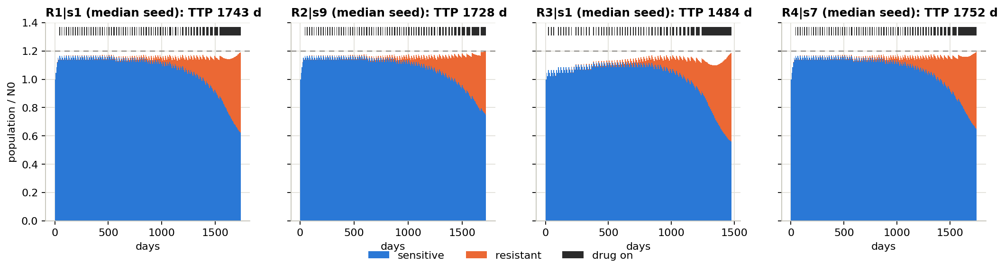
What each AI actually does to the tumour
E4 · RESULTS (3 OF 3)
How to read it: one typical AI per goal. Blue = sensitive cells, orange = resistant, black ticks = weeks on drug, dashed line = failure.
All four give short weekly pulses to stay under the line. The resistant clone still grows, and failure comes when it alone fills the space.
Notes:
This is containment in practice. Near the end the drug is on almost every week, because the resistant part is big enough that every week threatens failure. The R3 AI keeps the tumour a little lower early on, which costs it about 260 days in the end.

Slide 27
Choosing R3 is the costly mistake
E4 · WHAT WE FOUND
1
Training on R3 loses 12–18% of the possible score on every other goal.
2
R1, R2 and R4 cost each other at most 2%: they are almost interchangeable.
3
Our starting guess was wrong. An AI aiming to keep the mix does not outlast one aiming to survive.
4
It is the reverse: survival-trained AIs even score higher on R3’s own goal (0.78 vs 0.76).
Notes:
The idea behind our original hypothesis was that keeping a balanced mix would be a smarter long-term route to survival. In this model it is not: aiming directly at survival also gives a better mix than aiming at the mix.

Slide 28
Do different goals produce different strategies?
E5 · METHOD
1
For each AI we found its threshold: the tumour size above which it treats.
THE QUESTION
Even when two AIs last equally long, do they make different decisions?
2
For every pair of AIs: how often would they choose differently in the same situation?
3
Copies trained on the same goal also disagree a little: that is the “luck” level.
4
Two goals count as different only if they disagree clearly more than luck.
Notes:
We compare decisions only in situations that actually happen to a patient, not in impossible ones. Two measures are used: how often the AIs pick different doses, and a statistical distance between their probabilities (KL divergence). A permutation test with 5000 shuffles decides whether a gap is bigger than luck, with a correction for testing six pairs.

Slide 29
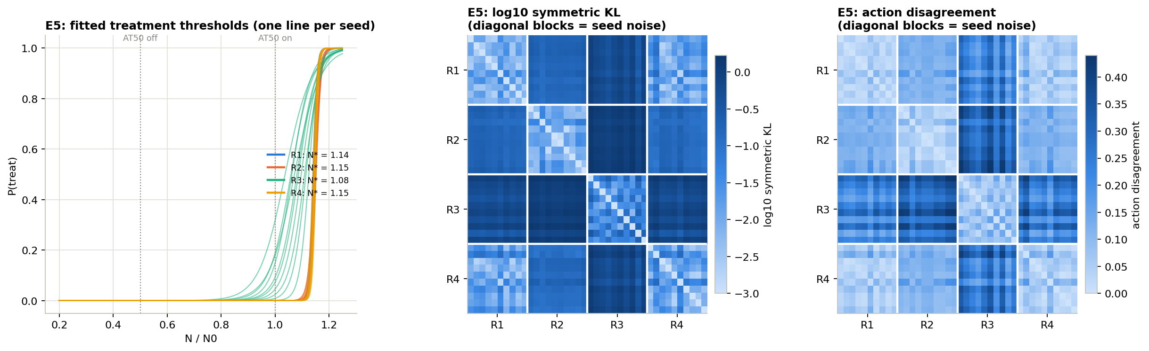
Thresholds, and how much the AIs disagree
E5 · RESULTS (1 OF 2)
Left: chance of treating vs tumour size, one line per AI. Middle and right: every AI against every other; darker = more different. Blocks on the diagonal = copies of the same goal (the luck level).
Notes:
Left panel: R1, R2 and R4 lines all jump from never treating to always treating at about 1.14 to 1.15 times the starting size. R3 lines are spread out and start treating earlier (1.08). Right panels: the R3 row and column are darkest, meaning R3 differs most from everyone. The R1 and R4 blocks look like the diagonal blocks, meaning they are as similar as copies of the same goal.

Slide 30
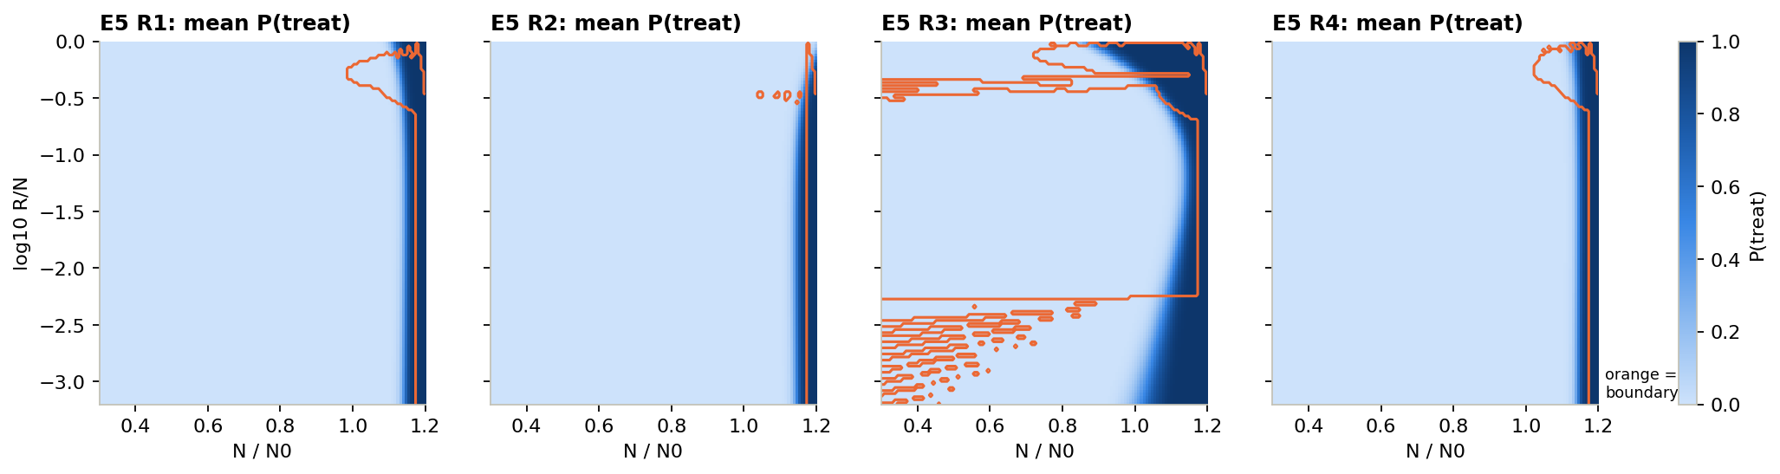
Where each AI chooses to treat
E5 · RESULTS (2 OF 2)
How to read it: across = tumour size, up = share of resistant cells. Dark = the AI treats. The orange outline is where the best plan treats.
R1, R2 and R4 learned the thin strip near the failure line. R3 learned a much wider treat area.
Notes:
Compare with E2: the AIs reproduce the shape of the best plans quite well, but their strip sits a little to the left of the orange line. Treating slightly earlier is a safety margin the AIs learned on their own.

Slide 31
Different goals, different strategies, except R1 and R4
E5 · WHAT WE FOUND
1
5 of 6 pairs of goals lead to clearly different strategies.
2
R1 and R4 cannot be told apart from luck: survival and lasting control are the same strategy.
3
Same survival, different choices: R1 and R2 disagree on 13% of decisions (luck: 4.7%).
4
Every AI treats a bit earlier than the best plan (1.08–1.15 vs 1.17): a built-in safety margin.
Notes:
So the goal does change the learned strategy, mostly in the details. The one big change is R3. And the pair R1 and R4, survival and lasting control, comes out as one strategy here and in almost every later test.

Slide 32
Stress tests
PART 3 · E6, E7, E8, E9, E10, E3C
Do the results survive a different mix target, new patients, wrong model numbers, fewer check-ups, other drugs and slower resistant cells?

Slide 33
Would a different mix target help R3?
E6 · METHOD
1
We rewarded the AI for keeping the resistant share near 5%, 10%, 25% or 50%.
THE QUESTION
R3 aims for a 50:50 mix. Would a smaller share of resistant cells work better?
2
We trained 5 AIs per target and worked out the best plan for each.
3
We measured days to failure and the resistant share actually reached.
4
E6b: we repeated the best plans on patients who can be controlled forever.
Notes:
The worry behind this experiment: maybe R3 only does badly because a 50:50 mix is a silly target. If a 5% or 10% target worked much better, the problem would be the target, not the idea of rewarding a mix.

Slide 34
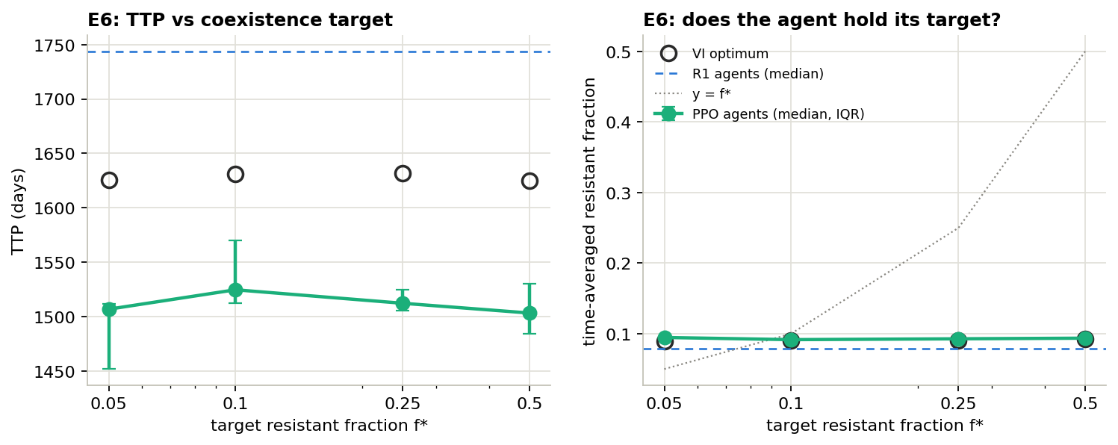
The target makes almost no difference
E6 · RESULTS
Left: days to failure per target (green = AIs, circles = best plan, blue dashed = survival-trained AIs). Right: resistant share reached; the grey dotted line is “hit the target exactly”.
Notes:
Numbers: AIs 1507, 1524, 1512 and 1503 days for targets 5%, 10%, 25% and 50%; the best plans 1625 to 1631 days. Average resistant share 9.2 to 9.5% for every target. In E6b, on a patient who never fails, the best plan held each target almost exactly (4.9%, 9.7%, 24.3%, 48.5%).

Slide 35
You cannot hold a fixed mix in a tumour that will fail
E6 · WHAT WE FOUND
1
Every target gives about 1510 days, well below survival-trained AIs (1744).
2
The real resistant share stays near 9% whatever the target, for the AI and the best plan alike.
3
Why: in a patient who will fail, resistant cells keep growing under every schedule.
4
Targets are held only in patients who never fail (E6b), where they no longer matter.
Notes:
This explains R3’s poor results. The problem is not the choice of target: a stable two-cell mix is simply not reachable in a tumour that is going to progress. The reward then reduces to “treat early, then contain”, which costs survival.

Slide 36
Does it work on patients the AI has never seen?
E7 · METHOD
1
We made virtual patients whose resistant cells grow 0–40% slower and whose cells die naturally at different rates.
THE QUESTION
Our AIs learned on one patient. What happens on 20 new ones?
2
“Generalist” AIs practised on many random patients (5 per goal).
3
We tested them, and the original one-patient AIs, on 20 patients none had seen.
4
For each new patient we also worked out its own best possible plan.
Notes:
The patient range is a box of cost of resistance from 0 to 0.4 and turnover from 0 to 0.04, all below the line where patients would never fail. This is the classic “does it generalise?” test.

Slide 37
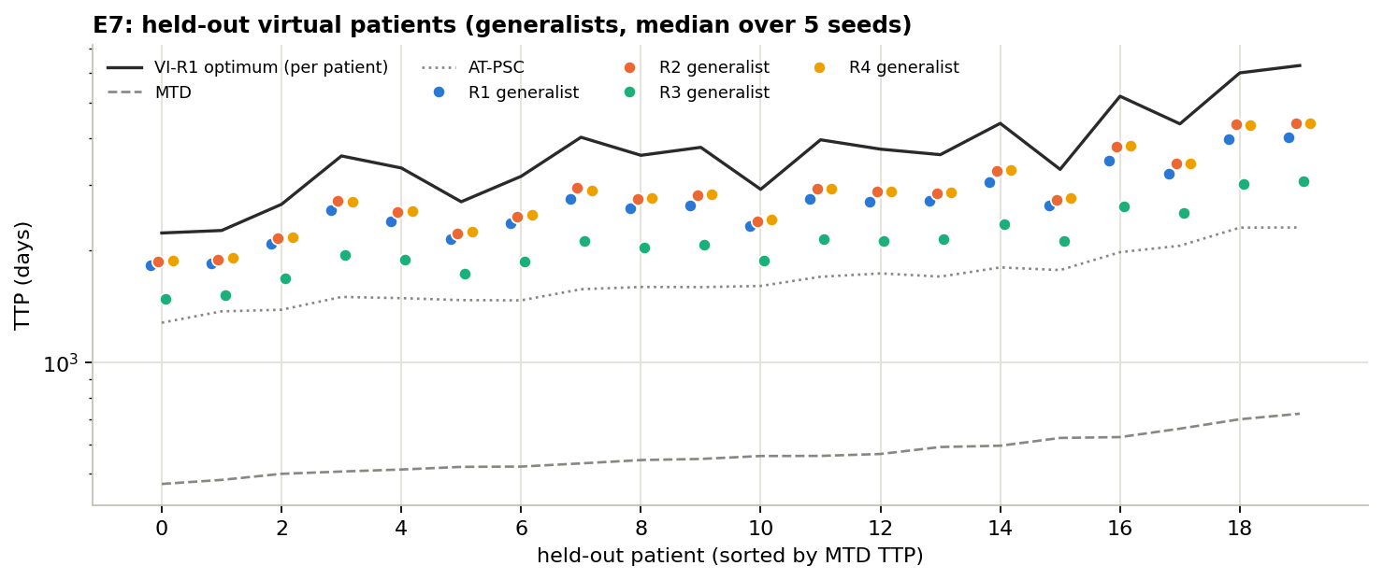
On new patients, R3 still comes last
E7 · RESULTS
How to read it: each column is one new patient. Black line = that patient’s best plan, dotted = best human rule, dashed = full dose. Dots = AIs per goal (green = R3). Middle days: R1 2651 · R2 2804 · R3 2075 · R4 2782.
Notes:
The y-axis is on a log scale, so equal gaps mean equal ratios. On every one of the 20 patients the green R3 dot is the lowest AI. The best plans for these patients have a median of 3613 days, and the best human rule about 1600.

Slide 38
The main result carries over to new patients
E7 · WHAT WE FOUND
1
R3 is last on all 20 new patients.
2
AIs still beat the best human rule: 2650–2800 days against about 1600.
3
Surprise: AIs trained on just one patient did slightly better than the generalists.
4
R1 vs R2 vs R4 changes from patient to patient, so we do not claim one of them is best.
Notes:
The AIs reach 57 to 77% of each new patient’s best plan, lower than on the training patient, because the new patients live much longer and leave more room. Specialists trained on our patient scored R1 2772, R2 2837, R3 2273, R4 2828 days.

Slide 39
What if our model numbers are wrong?
E8 · METHOD
1
We randomly changed each patient number (growth, drug strength, resistant share, cell death) by up to ±15%, ±20% or ±25%.
THE QUESTION
Real patients never match the model exactly. Do the strategies still work?
2
The AIs and the best plans kept what they learned on the original numbers.
3
We treated many of these “slightly wrong” patients and recorded days to failure.
4
We checked whether the order of the goals stayed the same.
Notes:
This mimics a clinic where the model was fitted to a patient but the fit is imperfect. Only the speed-type numbers were changed; starting size and capacity stayed fixed. The best plan here is the one computed for the original patient, applied unchanged to the perturbed one.

Slide 40
AIs hold up; the exact best plan breaks
E8 · RESULTS
1680–1730
1450–1500
110–160
days: AIs trained on R1, R2 and R4, even with ±25% wrong numbers
days: AIs trained on R3, still last at every error level
days: the exact best plan, in its worst quarter of patients
How to read it: there is no graph for this experiment. Numbers are middle values over many randomly changed patients, at ±15%, ±20% and ±25% error; the result was similar at every level.
Notes:
The best plan does well on most perturbed patients, but in about a quarter of them it fails within a few months. That is because it keeps the tumour right at the failure line; if the patient grows a little faster than planned, the line is crossed before the next weekly decision.

Slide 41
A safety margin beats a perfect plan for the wrong patient
E8 · WHAT WE FOUND
1
AIs barely notice model errors up to ±25%.
2
The exact best plan is fragile: it rides right on the failure line, so small errors push it over.
3
The AIs’ habit of treating a little early (E5) is what protects them.
4
R3 still comes last at every error level.
Notes:
The practical lesson: a plan computed from a model should never be used without a margin of safety. The AIs give up about 15% of survival in the perfect model in exchange for much better reliability when the model is wrong.

Slide 42
What if the patient is checked less often?
E9 · METHOD
1
We trained AIs to decide every day, every week, or every 28 days.
THE QUESTION
Clinics can’t scan every week. Does the check-up rhythm matter?
2
Each was tested at all three rhythms: 9 combinations per goal.
3
The chosen dose is kept until the next check-up.
4
Every AI got the same number of practice decisions, whatever its rhythm.
Notes:
Gallagher et al. reported that AIs trained with frequent check-ups break when checked less often. We wanted to see if that holds here, for all four goals. Keeping the number of practice decisions fixed is fair in one sense but unfair in another: a daily AI sees seven times fewer simulated days than a weekly one.

Slide 43
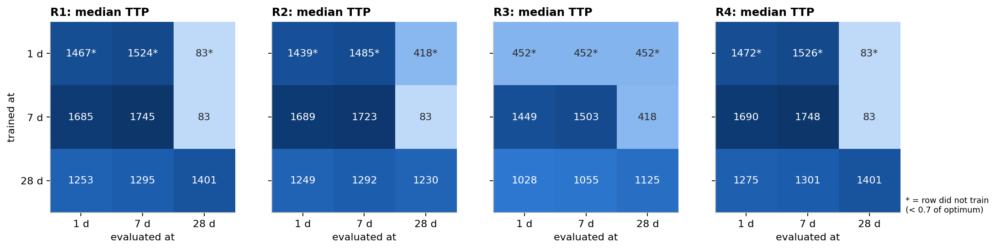
Checking less often than trained is dangerous
E9 · RESULTS
How to read it: one table per goal. Rows = how often the AI was trained to decide; columns = how often it is checked in the test. Numbers = days to failure; * = that AI did not train well.
Best possible plan: daily 2233 · weekly 2038 · monthly 1400 days.
Notes:
Look at the right-hand column of each table: AIs trained daily or weekly and then checked monthly fail at 83 days in R1 and R4, worse than any human rule. The bottom row, monthly-trained AIs, holds up across all columns. The daily row is starred: those AIs did not reach our 0.7 bar, and the R3 one fell back to always treating (452 days).

Slide 44
Check at least as often as the AI was trained
E9 · WHAT WE FOUND
1
Weekly-trained AIs checked monthly fail fast, often by day 83.
2
Monthly-trained AIs work at every rhythm and reach 89–100% of the monthly best plan.
3
Fewer check-ups lower the ceiling: the best plan drops from 2038 days (weekly) to 1400 (monthly).
4
Daily AIs under-trained because they saw 7× fewer simulated days, so this says little about daily checks.
Notes:
This replicates the asymmetry Gallagher et al. reported. For a clinic, the lesson is simple: an AI trained with frequent scans must not be used with infrequent ones. Among AIs used at their own training rhythm, R3 still comes last.

Slide 45
What if the drug works differently?
E10 · METHOD
1
We kept the AIs trained on our standard drug model.
THE QUESTION
Our model assumes one way the drug acts. Do the AIs still work if that is wrong?
2
We tested them with two other drugs: one that only stops growth, and one that kills a fixed share of cells.
3
We compared with full dose, the best human rule and a best plan worked out again for each drug.
4
We repeated it with the generalist AIs on the 20 new patients from E7.
Notes:
The growth-stopping drug is called cytostatic; it matches how hormone therapy acts in prostate cancer (Ma 2026). The fixed-share killer is called log-kill. The AIs were never retrained: this tests what happens when the model they learned from is wrong about the drug.

Slide 46
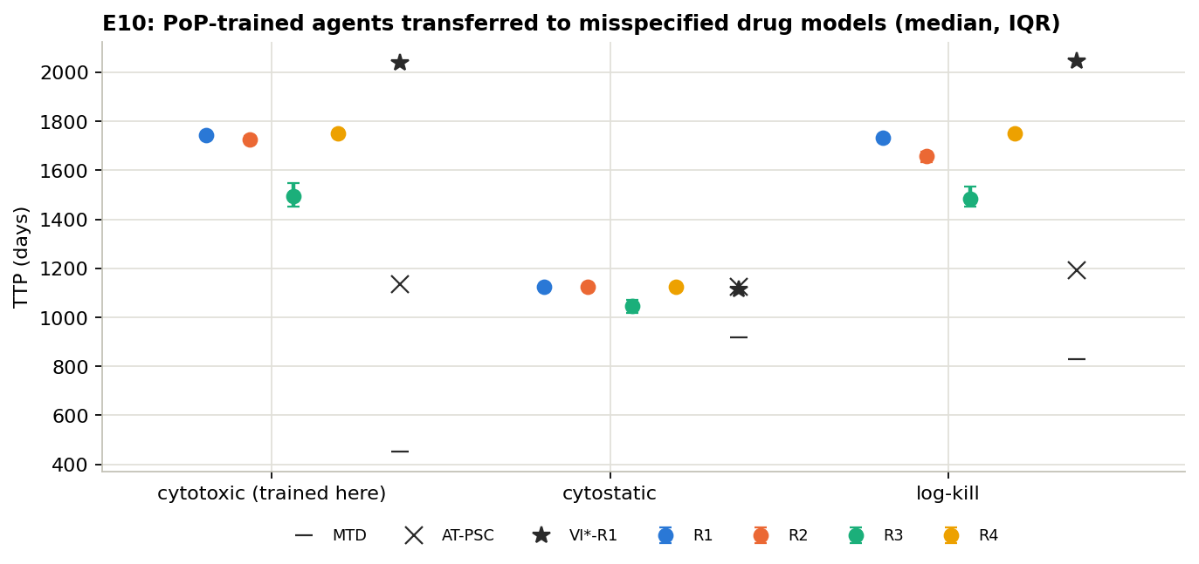
The AIs carry over to other drugs
E10 · RESULTS
Days | Standard | Stops growth | Log-kill
AI R1 | 1744 | 1126 | 1732
AI R3 | 1494 | 1048 | 1485
Full dose | 452 | 919 | 828
AT50 | 673 | 919 | 828
AT-PSC | 1135 | 1126 | 1192
Best plan | 2038 | 1113 | 2045
How to read it: dots = AIs per goal, star = best plan for that drug, × = best human rule, dash = full dose. The AIs were trained only on the standard drug.
Notes:
R2 and R4 AIs behave like R1 here: 1726 and 1751 days on the standard drug, 1126 each with the growth-stopping drug, and 1658 and 1752 with log-kill. On the 20 new patients, generalists kept the same order with every drug: R3 lowest (about 2020 to 2075 days), the others 2540 to 2800.

Slide 47
AIs survive a wrong drug model; some human rules don’t
E10 · WHAT WE FOUND
1
Log-kill drug: AIs work almost unchanged (1732 vs 1744 days), while AT50 drops to full-dose level (828).
2
Growth-stopping drug: every option lands at 920–1130 days, and the AIs match the re-solved best plan.
3
R3 is still last with both drugs.
4
The same holds on the 20 new patients with the generalist AIs.
Notes:
With the growth-stopping drug there is little room for any schedule: the drug can only pause the sensitive cells, not shrink them, so full dose, AT50 and AT90 all tie at 919 days and the best possible plan reaches only 1113. The AIs at 1126 even edge slightly past the planner, which is possible because the planner works on a grid.

Slide 48
Does it hold when resistance has a cost?
E3C–E5C · METHOD
1
Same patient, but resistant cells grow 42% slower, a value measured in prostate cancer (Zhang 2022).
THE QUESTION
Our resistant cells grow as fast as sensitive ones. What if resistance slows them down?
2
We repeated E2 to E5 exactly: best plans, 40 new AIs, cross-scoring, strategy comparison.
3
Same settings, same training length, same 0.7 bar.
4
We also tried giving “lasting control” (R4) 5× and 10× more weight.
Notes:
A cost of resistance is common in biology: the machinery that makes a cell resistant uses energy, so it grows more slowly. Adaptive therapy is expected to work even better with such a cost. The real question is whether our conclusions about the goals change.

Slide 49
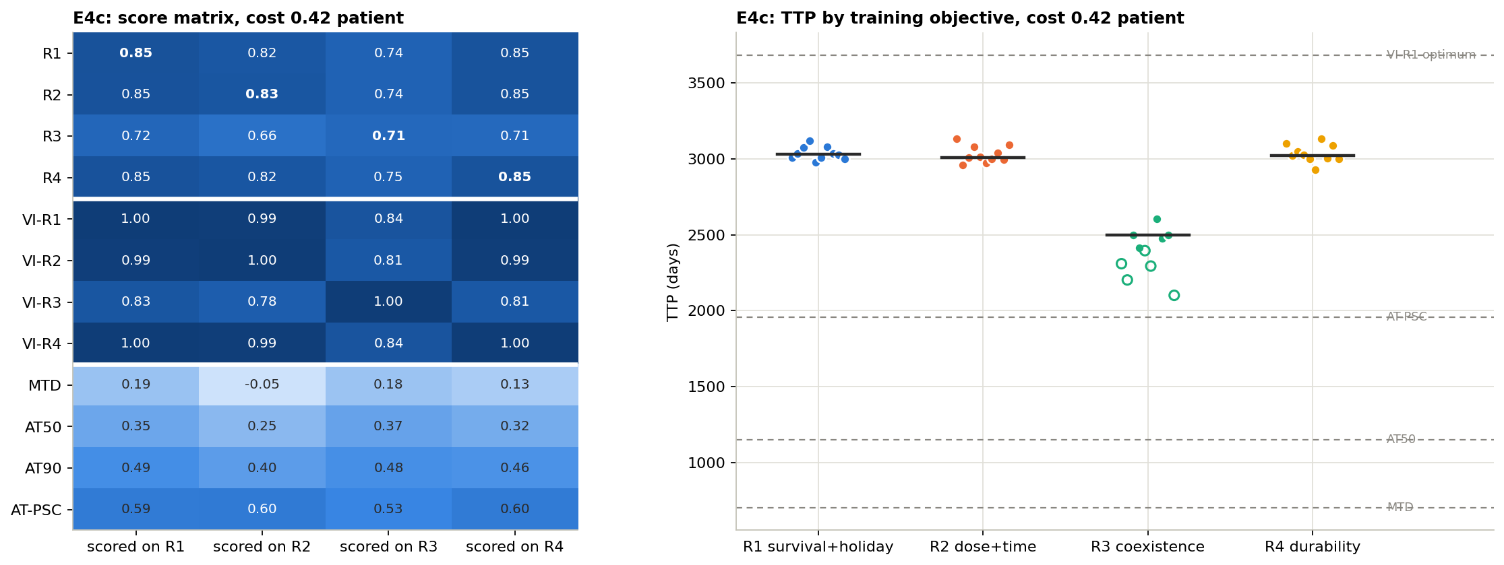
Same pattern, just everything lasts longer
E3C–E5C · RESULTS (1 OF 3)
How to read it: left = every strategy on every goal (as in E4). Right = days to failure per AI; hollow dots did not train. Middles: R1 3031 · R2 3009 · R3 2498 · R4 3024. Best plan 3683, best human rule 1959.
Notes:
Everything lasts about 1.7 times longer than on our main patient, because slower resistant cells take longer to take over. Five of the ten R3 AIs fell below the 0.7 bar and were excluded; longer patients mean fewer practice patients in the same training budget, which hits the hardest goal first.

Slide 50
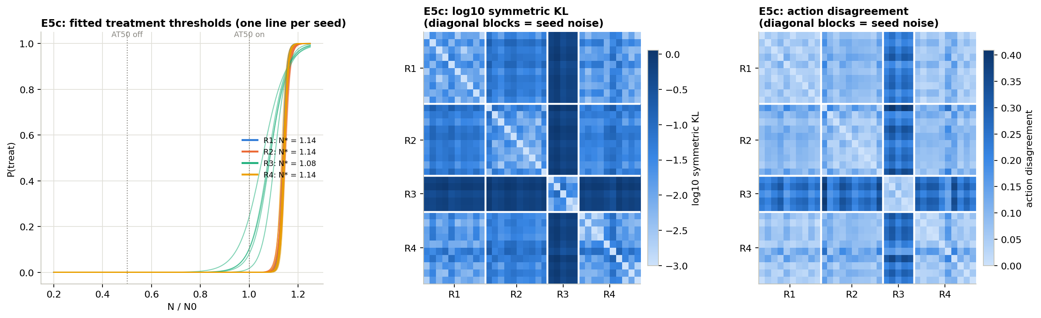
Strategies: R3 differs, R1 and R4 do not
E3C–E5C · RESULTS (2 OF 3)
How to read it: left = chance of treating vs tumour size (thresholds R1, R2, R4 1.14; R3 1.08). Middle and right = difference between AIs; darker = more different, diagonal blocks = luck level.
Notes:
This is the same analysis as E5. Only the five R3 AIs that trained are included, which is why the R3 block is narrower. As before, five of six goal pairs differ beyond luck, and R1 versus R4 does not.

Slide 51
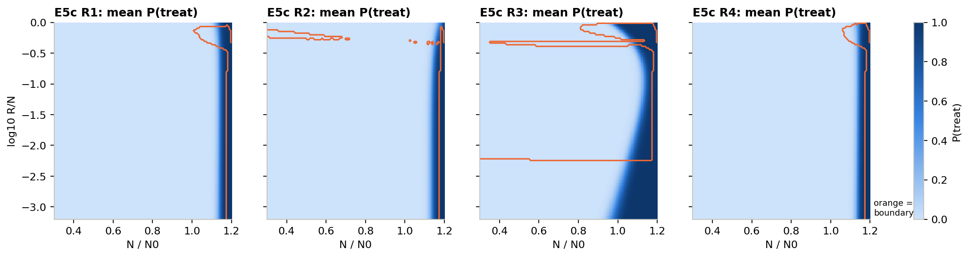
Where each AI treats on this patient
E3C–E5C · RESULTS (3 OF 3)
How to read it: across = tumour size, up = share of resistant cells, dark = the AI treats, orange outline = where the best plan treats.
It looks almost the same as on our main patient (E5): a thin strip for R1, R2 and R4, a wide area for R3.
Notes:
Compare side by side with the E5 maps: the shapes are nearly identical. A cost of resistance changes how long the patient lives, but not what kind of strategy each goal leads to.

Slide 52
The conclusions carry over
E3C–E5C · WHAT WE FOUND
1
Everything lasts about 1.7× longer (best plan 3683 days), but the ranking is unchanged.
2
R3 costs 13–17% on the other goals; R1, R2 and R4 cost each other under 1%.
3
R1 and R4 are again the same, at the best plan and in the AIs.
4
More weight on R4 only teaches “give up early”. Close that loophole and containment returns.
Notes:
The weight check: with 5× or 10× weight on lasting control, the plan stops treating once a week of survival would score negatively, so the patient fails sooner. That is a loophole in the reward, not a better strategy. When we also made failure cost as much as in R2, the plan went straight back to containment.

Slide 53
What the AI is allowed to see
PART 4 · E11, E11B, E11C, E11D
So far the AI saw the exact mix of sensitive and resistant cells. A doctor only sees tumour size. What changes?

Slide 54
What if the AI only sees tumour size?
E11 · METHOD
1
Same as E3, but the AI sees one number: tumour size compared to the start.
THE QUESTION
Doctors see a tumour marker like PSA, not the cell mix. Can the AI learn from size alone?
2
No memory: only this week’s size.
3
10 AIs per goal, scored against the full-information best plan.
4
To see if size alone is enough, we also tested the simple rule “treat if size ≥ θ” for many values of θ.
Notes:
This is the clinically realistic setting: in prostate cancer, PSA tracks total tumour size but says nothing about how many cells are resistant. It is also the input Gallagher’s AI used before adding memory.

Slide 55
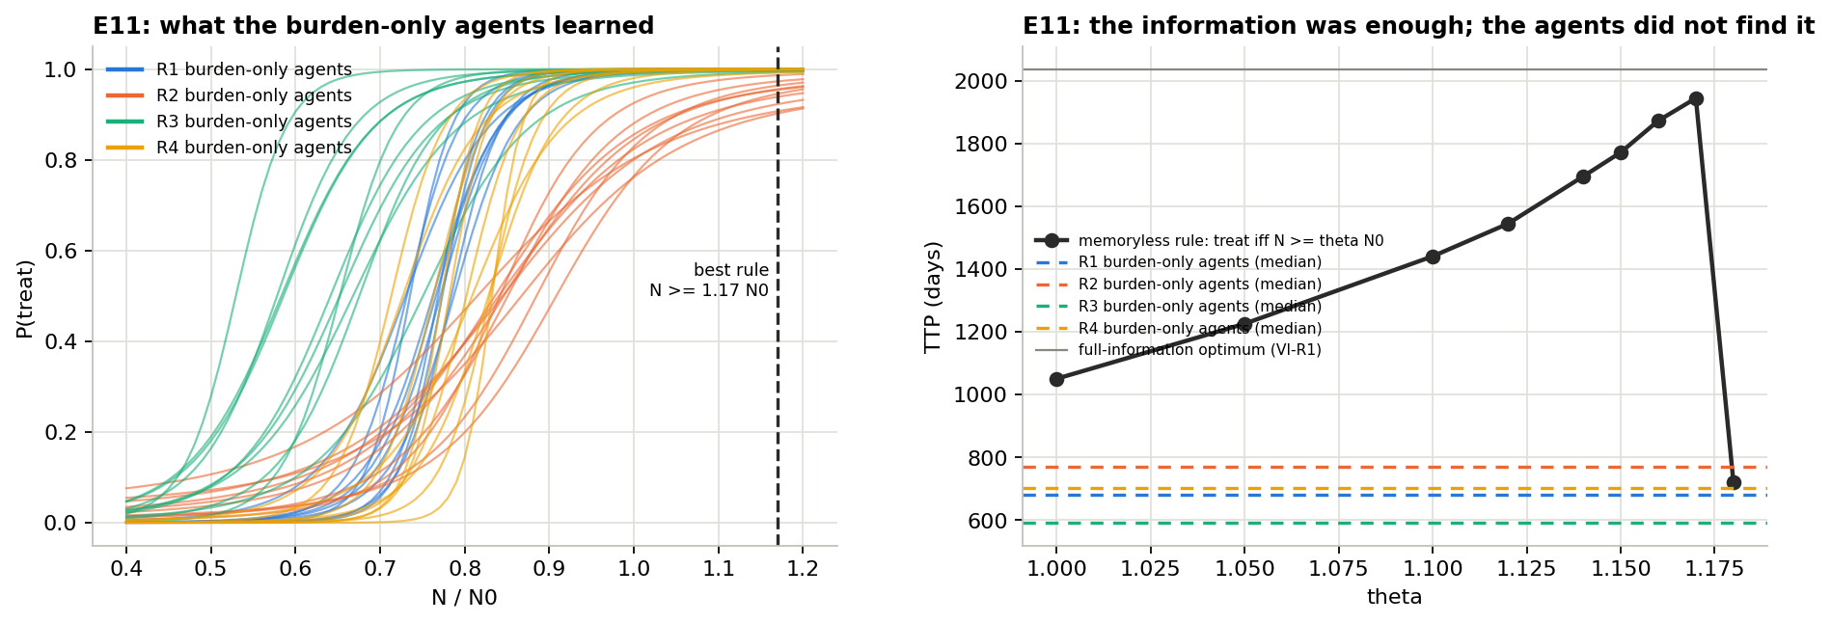
Size-only AIs failed, but a simple size rule works
E11 · RESULTS
Left: when each size-only AI treats; they treat far too early. Right: days for the rule “treat if size ≥ θ”; the best θ = 1.17 gives 1945 days. Dashed lines = the AIs (590–770 days).
Notes:
The right panel is the key: the black line shows that a rule using only tumour size can get within 4% of the full-information best plan, as long as the threshold is right. The AIs, which also see only size, end up far below it, close to where AT50 sits.

Slide 56
The information was there; the AI couldn’t learn it
E11 · WHAT WE FOUND
1
No size-only AI trained: scores 0.21–0.37, about 700 days, close to AT50.
2
They treat far too early, at 65–85% of the starting size instead of 117%.
3
Size alone is enough: “treat if size ≥ 1.17 × start” reaches 1945 days, 96% of the best.
4
So the problem is learning. The AI’s internal judge can’t tell apart situations that look the same in size.
Notes:
The internal judge is the critic: the part of the AI that estimates how good a situation is. Seeing only size, it averages over tumours with very different futures (mostly sensitive versus mostly resistant), so its advice is misleading. This is called critic aliasing, and E11b tests the fix.

Slide 57
Give the AI a better teacher during training
E11B · METHOD
1
An AI has two parts: a decision-maker and an internal judge that rates situations.
THE QUESTION
Can we fix the size-only AI by changing how it trains, not what it sees?
2
The decision-maker still sees only tumour size, as in the clinic.
3
During training only, the judge sees the full cell mix from the simulator.
4
After training the judge is dropped; the AI you would use sees size only.
Notes:
In technical terms this is an asymmetric actor–critic: the actor (decision-maker) and critic (judge) get different inputs. It is fair to use here because in a simulator the full state is always known during training. Everything else is identical to E11: 10 AIs per goal, the same training length and the same scoring.

Slide 58
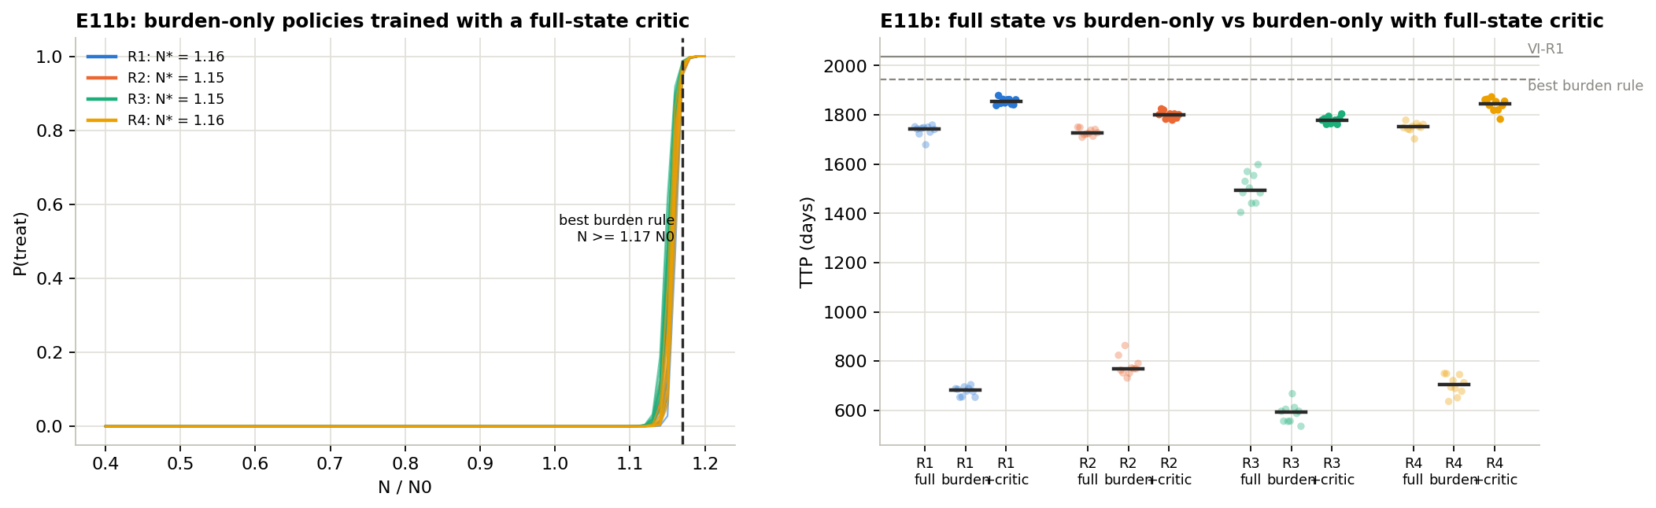
Every size-only AI now trains, and does better
E11B · RESULTS (1 OF 3)
Left: when each AI treats; every goal switches sharply at about 1.15 × start. Right: days to failure for full information (“full”), size only (“burden”) and size only with the better judge (“+critic”).
Notes:
In the right panel, each goal has three columns. The middle one is E11 (failed). The right one is this experiment: higher than the left one, which is the full-information AI from E3. The grey lines are the full-information best plan (2038) and the best size-only rule (1945).

Slide 59
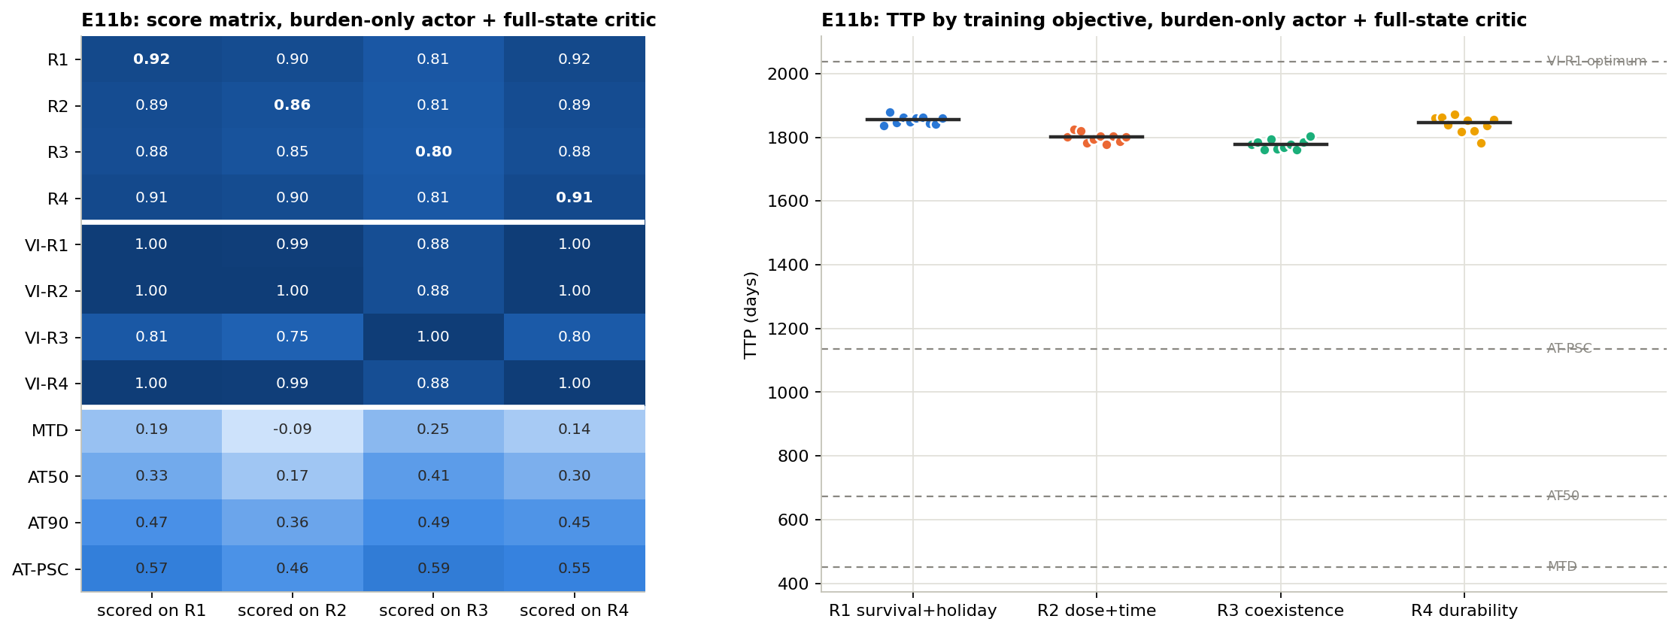
The four goals now end up almost the same
E11B · RESULTS (2 OF 3)
How to read it: left = every strategy on every goal (as in E4); AI rows now score 0.80–0.92 everywhere. Right = days per AI: R1 1855 · R2 1801 · R3 1779 · R4 1846.
Notes:
Compare with E4: the R3 row used to be 0.67 to 0.76; now it is 0.80 to 0.88. The worst cost of picking the wrong goal falls from 0.18 to 0.035. The dots on the right are also much tighter, so the ten copies agree closely.

Slide 60
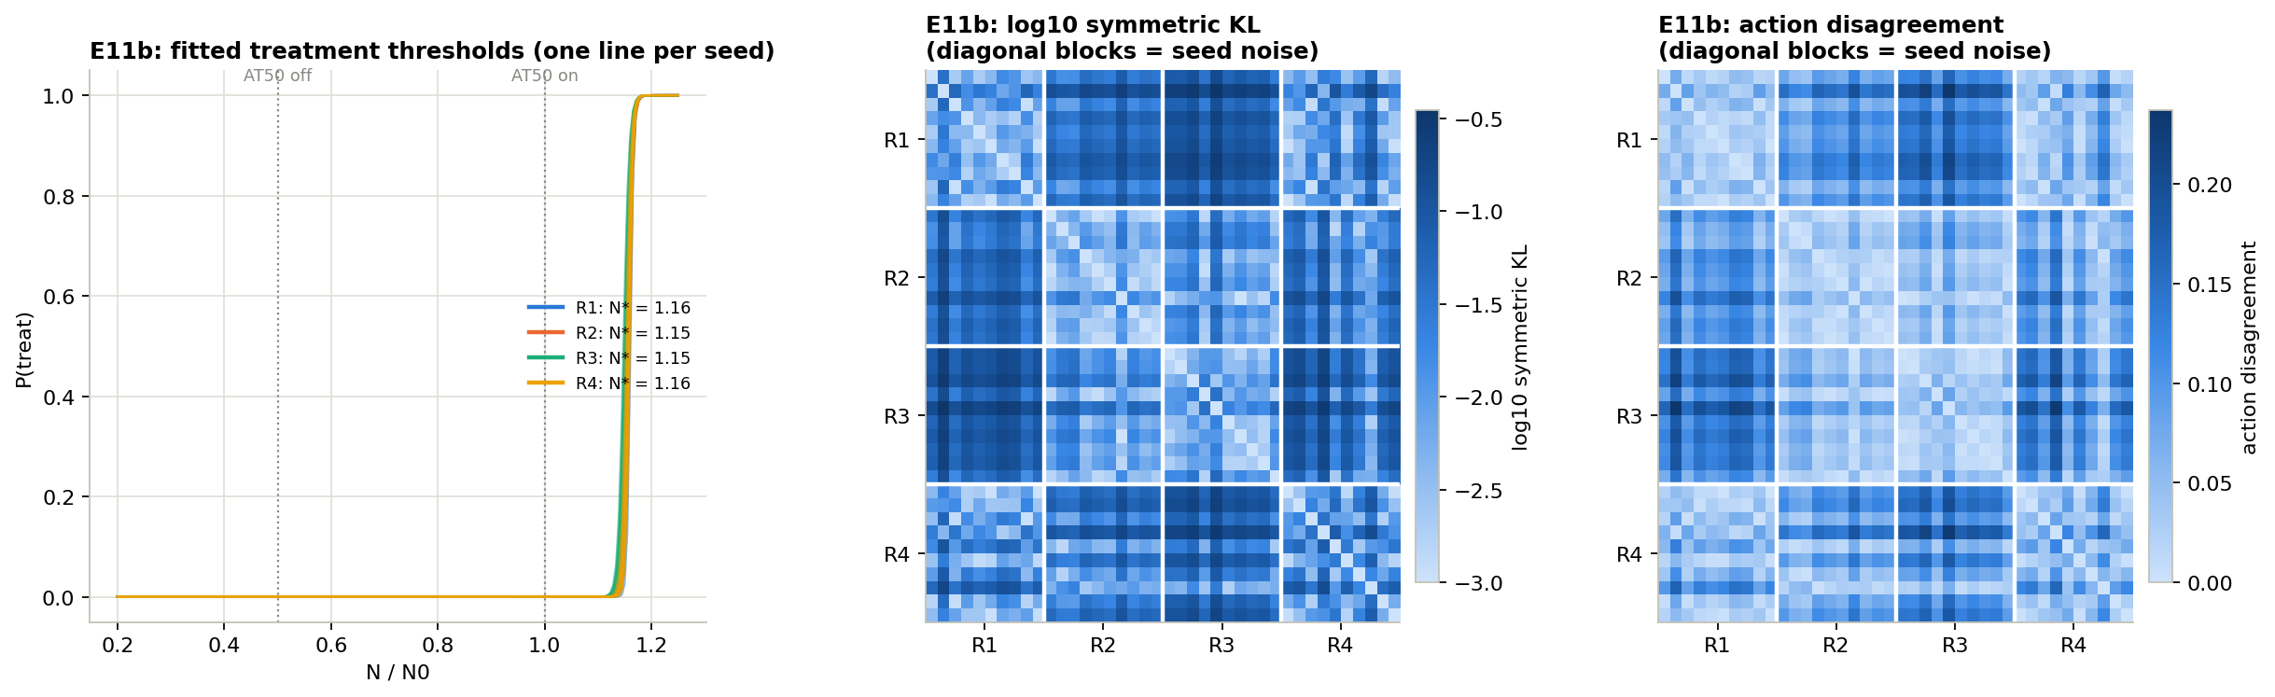
Strategies still differ, but only slightly
E11B · RESULTS (3 OF 3)
How to read it: left = chance of treating vs size (thresholds 1.15–1.16 for all goals). Middle and right = differences between AIs; note the scale now tops out near 0.2, half of E5’s.
Notes:
AIs from different goals now disagree on only 4 to 14% of decisions, against 13 to 33% with full information. Five of six goal pairs still differ beyond luck; R1 and R4 still do not. We also checked each goal’s full-information AI against its size-only AI: they differ in every case.

Slide 61
Seeing less made the AI better, and the goals matter less
E11B · WHAT WE FOUND
1
All 40 trained and beat the full-information AIs on every goal (1779–1855 vs 1494–1751 days).
2
Each learned one simple rule: treat when size passes about 1.15 × start.
3
The goals nearly merge: R1–R3 gap 250 → 76 days; wrong-goal cost 18% → 3.5%.
4
Why: R3 can’t chase a cell mix it cannot see. The big goal effect needed information doctors don’t have.
Notes:
This is one of the most important results of the project. The fix for size-only learning was cheap, and the resulting AIs are both closer to what a clinic could use and better. It also changes how we read Part 2: much of the difference between goals depended on the AI seeing the cell mix.

Slide 62
Does a memory of past check-ups help?
E11C · METHOD
1
The AI sees the last 8 weekly sizes and the last 8 doses, like a patient chart.
THE QUESTION
With two months of history, can the AI work out the hidden cell mix?
2
The better judge from E11b is kept (full mix, training only).
3
The idea: how fast the tumour shrinks on drug hints at how many cells are still sensitive.
4
We also measured drug use in the first 26 weeks: R3’s “treat early” signature.
Notes:
Memory is the only change from E11b. We used a simple sliding window of past readings rather than a more complex recurrent network, so the AI design stays the same. The specific question: if the AI can infer the mix, does R3’s distinct early-treatment behaviour come back?

Slide 63
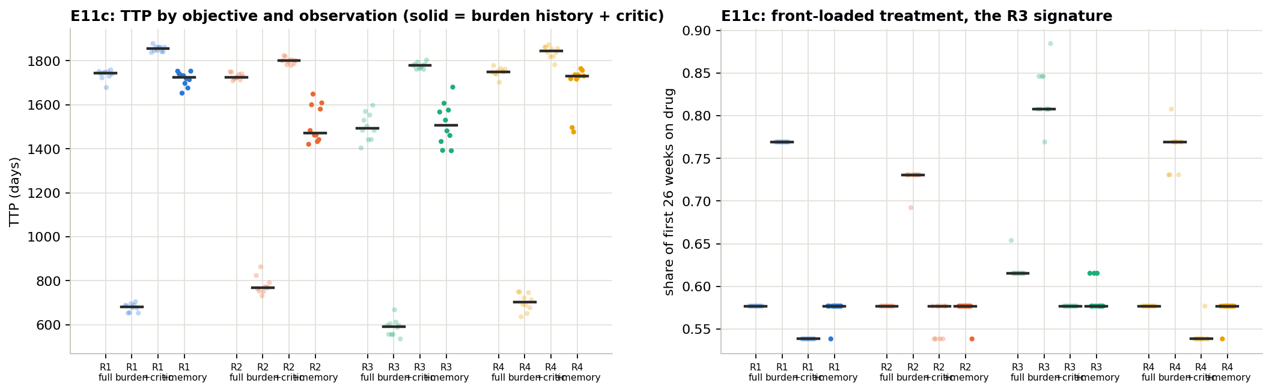
Memory brings back some differences
E11C · RESULTS (1 OF 3)
Left: days per goal in four settings: full information, size only (“burden”), size + better judge (“+critic”), size history + better judge (“+memory”). Right: share of the first 26 weeks on drug.
Notes:
In the left panel the memory column (right-most in each group) is lower and more spread out than the +critic column. In the right panel, only the full-information R3 AIs treat a lot early (0.62); with memory, R3 sits at 0.58 like everyone else. Three of ten memory R3 AIs did reach 0.62.

Slide 64
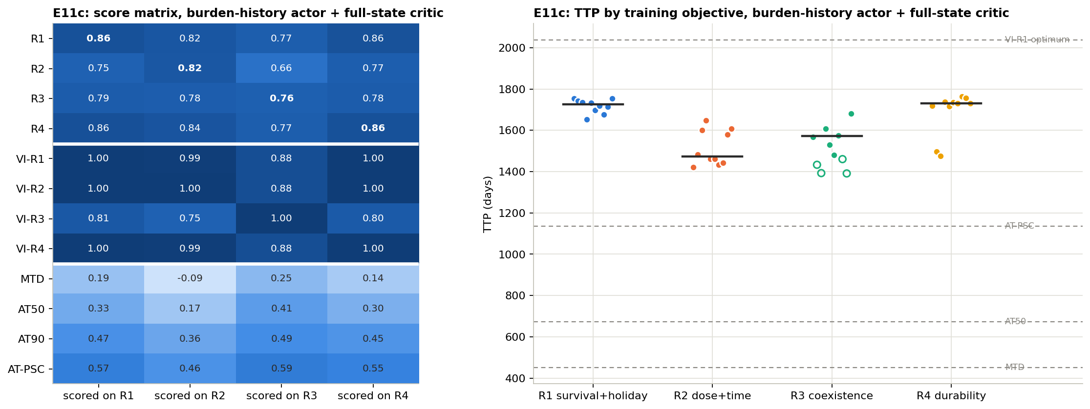
Scoring every memory AI on every goal
E11C · RESULTS (2 OF 3)
How to read it: left = every strategy on every goal (as in E4). Right = days per AI; hollow dots did not train. Middles: R1 1726 · R2 1473 · R3 1506 · R4 1731.
Notes:
Four of the ten R3 memory AIs fell below the 0.7 bar. The largest cost of the wrong goal is now 0.105, between the full-information level (0.18) and the size-only level (0.035). R2 has become the lowest in days, even below R3.

Slide 65
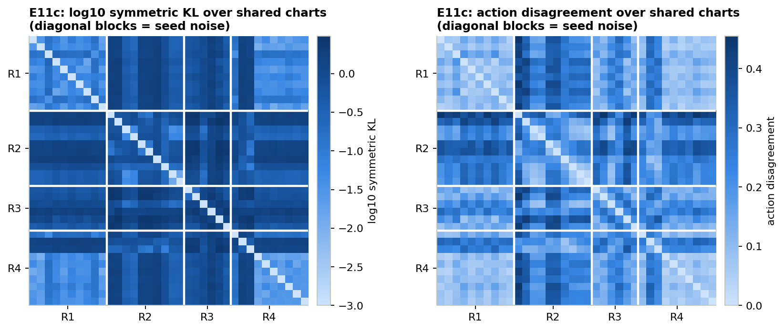
Memory AIs disagree much more among themselves
E11C · RESULTS (3 OF 3)
How to read it: darker = more different. Even copies of the same goal (diagonal blocks) now disagree a lot, about 4× more than in E11b. Four of six goal pairs still differ beyond that.
Notes:
Because memory AIs see a history, we compare them on the same set of real patient charts. The high disagreement between copies means each training run settles on a somewhat different strategy. That makes any single memory AI less predictable.

Slide 66
Memory makes learning harder and noisier
E11C · WHAT WE FOUND
1
Harder to learn: scores 0.71–0.86, and 4 of 10 R3 AIs fail.
2
The R1–R3 gap returns to 220 days, but R3’s “treat early” habit does not.
3
R2 becomes the odd one: 20% less drug, 15% shorter survival, yet R1-trained AIs score higher on R2’s own goal.
4
Copies disagree about 4× more than without memory.
Notes:
Point 3 matters: if R2-trained AIs were genuinely better at R2’s goal, they would score higher on it than R1-trained AIs. They do not. So R2’s different behaviour is a learning quirk: its reward is nearly flat (a week of drug costs about as much as a week of life is worth), so the AI gets stuck in a drug-saving local optimum. Was this just too little training? E11d checks.

Slide 67
Was it just too little training?
E11D · METHOD
1
Exactly the E11c setup: size history plus the better judge.
THE QUESTION
Would 3× more practice fix the memory AIs, and change the goal story?
2
3 million practice steps instead of 1 million, 10 AIs per goal.
3
We kept the 1-million AIs, so the only difference is training length.
4
We repeated cross-scoring and the strategy comparison.
Notes:
A memory AI has 16 inputs instead of 1, so it is reasonable to expect it needs more practice. If the R2 and R3 quirks from E11c disappeared with more training, they were just under-training. If they stayed, they are real features of how these goals are learned.

Slide 68
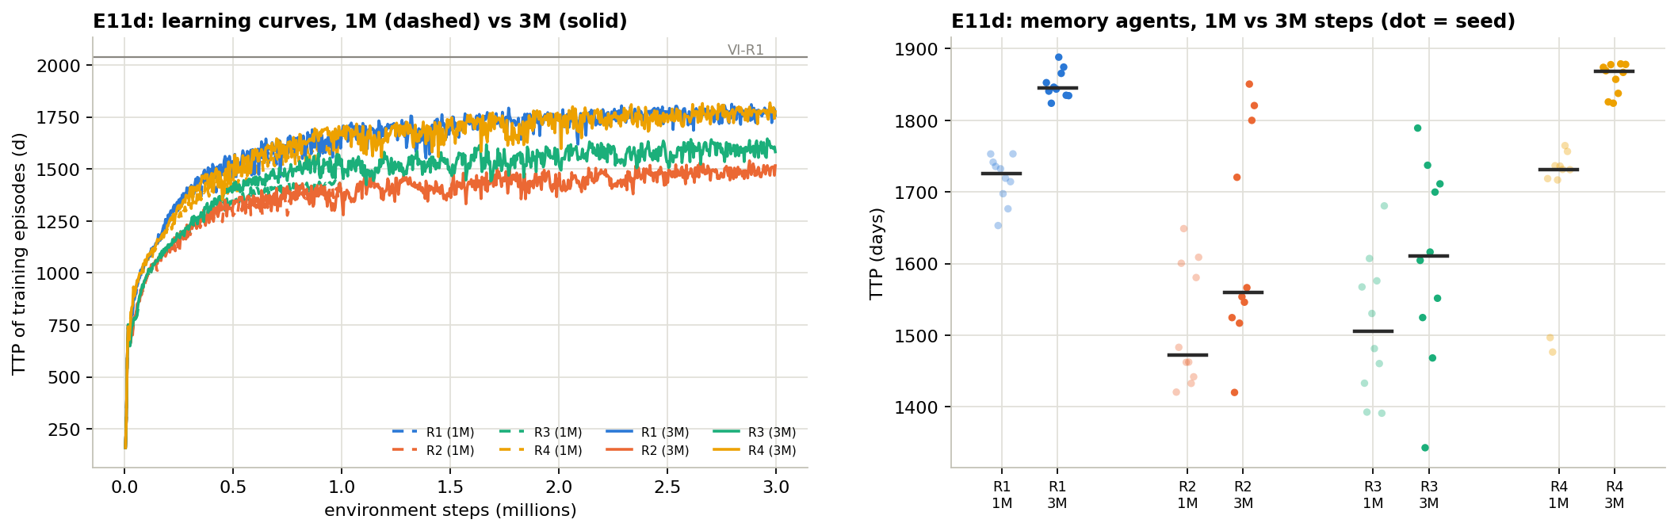
More practice helps R1 and R4 the most
E11D · RESULTS (1 OF 3)
Left: survival during practice (dashed = 1M steps, solid = 3M). Right: days per AI at 1M vs 3M. Middles at 3M: R1 1845 · R2 1560 · R3 1610 · R4 1868.
Notes:
The curves flatten by about 2 million steps, so more training would add little. The order of the goals, R1 and R4 on top, then R3, then R2, is already fixed by 0.5 million steps. R2 and R3 AIs remain widely spread across copies even at 3 million.

Slide 69

Scoring the longer-trained memory AIs
E11D · RESULTS (2 OF 3)
How to read it: left = every strategy on every goal; AI rows now reach 0.80–0.92 on their own goal. Right = days per AI; hollow dots did not train (now only 2 of 10 for R3).
Notes:
The largest cost of picking the wrong goal is 0.133 here (0.105 at 1 million). R2-trained AIs still use about 21% less drug and survive about 15% less, and R1-trained AIs still score higher on R2’s own goal.

Slide 70
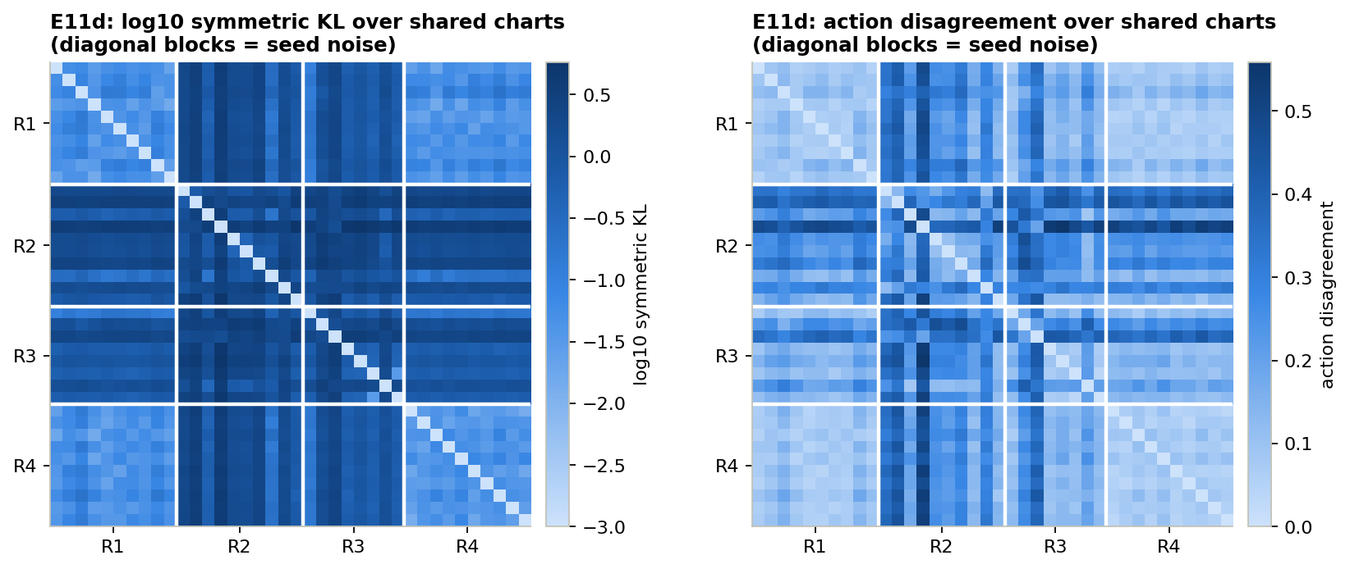
Copies still disagree as much as before
E11D · RESULTS (3 OF 3)
How to read it: darker = more different. The diagonal blocks (copies of one goal) look as dark as at 1M steps. Four of six goal pairs still differ beyond that.
Notes:
The average disagreement between copies of the same goal is 0.157 at 3 million steps, the same as at 1 million. So the variability is a property of having a 16-input memory, not a sign of under-training.

Slide 71
More practice raises scores, not the goal story
E11D · WHAT WE FOUND
1
Scores rise to 0.80–0.92, and 8 of 10 R3 AIs now train.
2
The goal effect stays: R1–R3 gap 235 days, wrong-goal cost up to 13%.
3
R2 and R3 AIs are no better at their own goals than survival-trained AIs: a learning dead end, not a smarter plan.
4
Copy-to-copy noise is unchanged: it comes from memory itself, not too little training.
Notes:
Taken together, Part 4 says: what the AI can observe changes how much the goal matters. Full information: a large goal effect. Size only with a good judge: almost none. Size history: some, but driven by learning quirks rather than better serving each goal. Only the memory AIs got 3× training here; the follow-up A2 gives the others the same budget.

Slide 72
The follow-up round
PART 5 · 14 FOLLOW-UP EXPERIMENTS
Fairness checks (A), extra analyses (B), a map of patients (C), more dose levels (D) and new biology (FE). 270 more AIs.

Slide 73
Does it hold when cells also die naturally?
A1 · METHOD
1
Same patient, but cells die naturally at 4% of their growth rate (turnover 0.04).
THE QUESTION
Both reference patients so far had no natural cell death. Does adding it change anything?
2
That is the highest value in our patient range, so it has the most chance to change things.
3
A full repeat of E2 to E5: best plans, 40 AIs, cross-scoring, strategy comparison.
4
Same settings and the same 0.7 bar as every other experiment.
Notes:
Strobl 2021 showed that cell turnover helps adaptive therapy, because the drug then actually shrinks the resistant population a little over time. This patient closes the gap “only tested on patients without turnover” that we listed as a limitation after the first round.

Slide 74
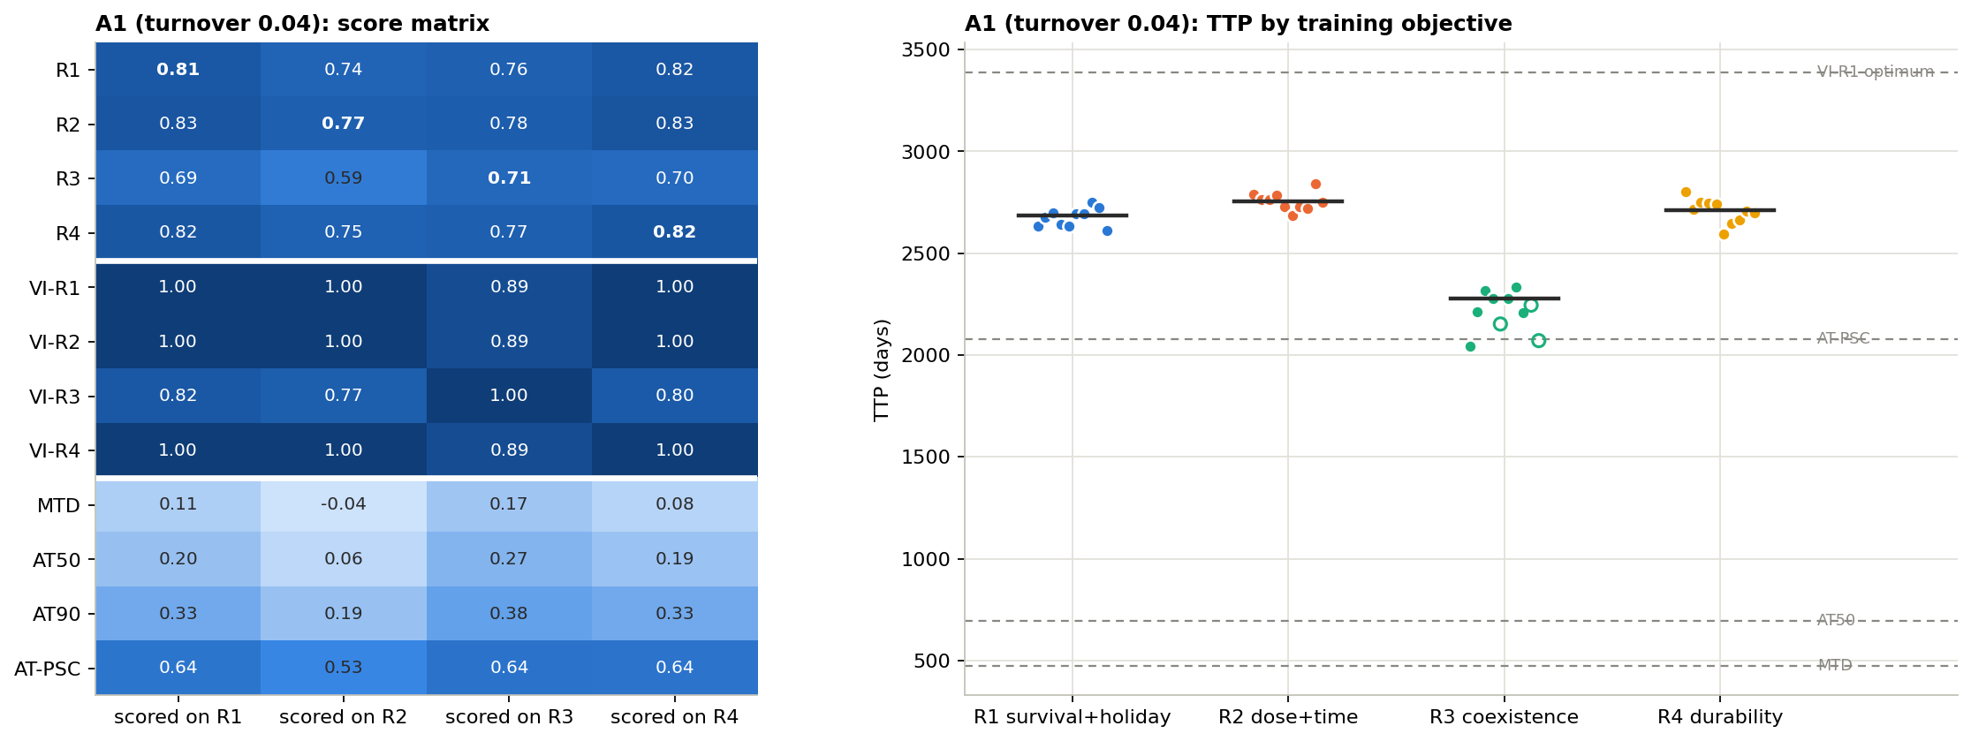
The same shape of results again
A1 · RESULTS (1 OF 2)
How to read it: left = every strategy on every goal; right = days per AI, hollow dots did not train. Middles: R1 2685 · R2 2757 · R3 2277 · R4 2713. Best plan 3389.
Notes:
On this patient the best human rule, AT-PSC, reaches about 2080 days, so the AIs beat it by roughly 30%. The R3 row is again the weakest across the board.

Slide 75
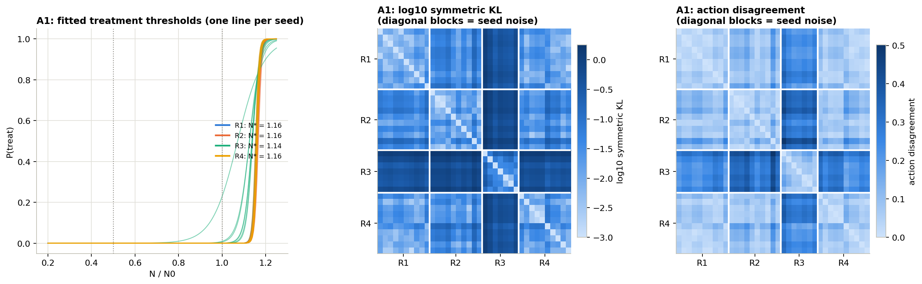
R3 differs; R1 and R4 cannot be told apart
A1 · RESULTS (2 OF 2)
How to read it: left = when each AI treats (thresholds R1 1.16, R2 1.16, R3 1.14, R4 1.16). Middle and right = differences between AIs; darker = more different, diagonal blocks = luck level.
Notes:
Measured as a ratio to the luck level, R1 versus R4 is 1.04, essentially identical. R3 differs from the others by 3.7 to 4.7 times the luck level.

Slide 76
A third kind of patient, the same answer
A1 · WHAT WE FOUND
1
R1, R2 and R4 share one best plan (3389 days); R3’s is 21% shorter.
2
R3 costs up to 17% on the other goals; R1, R2 and R4 cost each other at most 2.5%.
3
R1 and R4 are again the same; 5 of 6 pairs of goals differ.
4
7 of 10 R3 AIs trained, as we predicted: longer patients make R3 harder to learn.
Notes:
We now have three reference patients with very different biology (no cost and no turnover, a cost of resistance, and turnover), and all three give the same picture. Before training we wrote down that R3 seeds might fail on this patient; that prediction held.

Slide 77
A fair race: the same training for everyone
A2 · METHOD
1
We retrained the full-information AIs (E3) and the size + better judge AIs (E11b) with 3 million steps.
THE QUESTION
Only the memory AIs got 3× training. Was the comparison in Part 4 unfair?
2
All 4 goals × 10 AIs each, settings unchanged.
3
Now all three ways of seeing can be compared at equal training.
4
The 1-million AIs are kept, so we can also see what extra practice changes.
Notes:
This was the deferred item from the first round. If the size-only AIs only looked better because the full-information ones were under-trained, extra training for everyone would reverse the result. That is the risk this experiment checks.

Slide 78
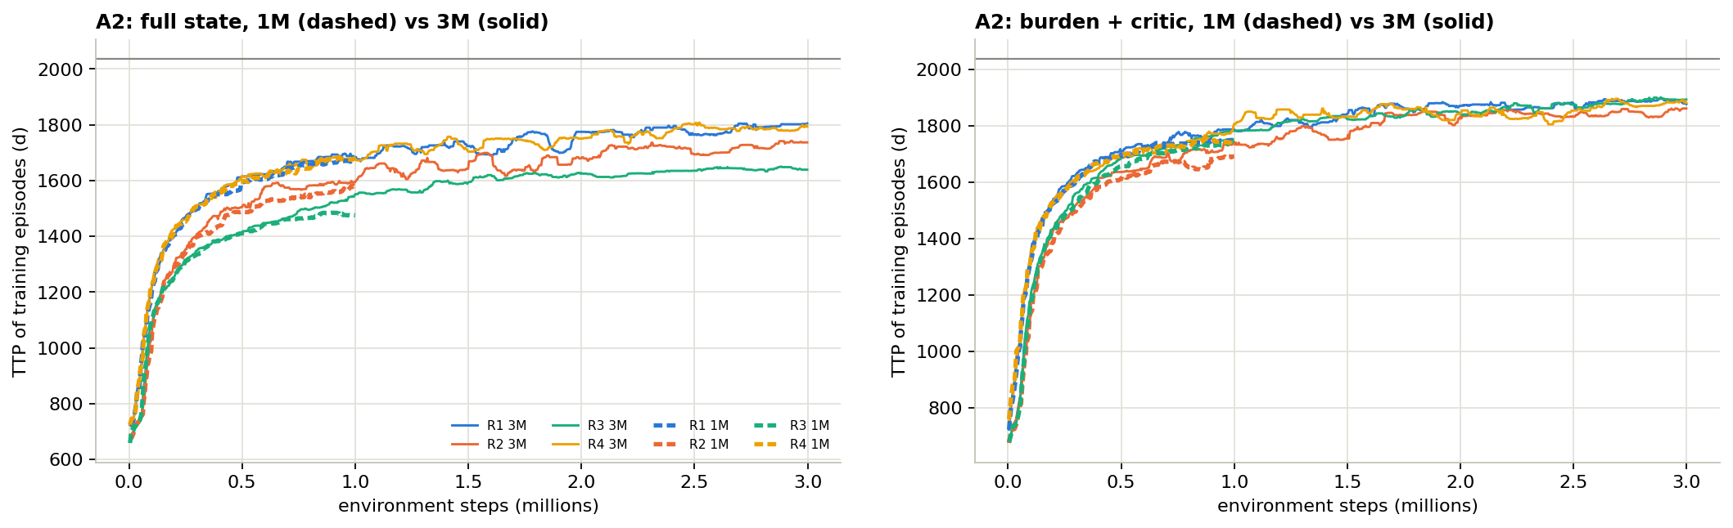
Both settings keep improving with practice
A2 · RESULTS (1 OF 3)
How to read it: survival during practice; dashed = first 1M steps, solid = the 3M run. Left = full information, right = size only + better judge. Grey line = best plan (2038 days).
Notes:
On the left, the four goals stay spread apart, with R3 lowest. On the right, the four lines run almost on top of each other and finish higher than any line on the left.

Slide 79
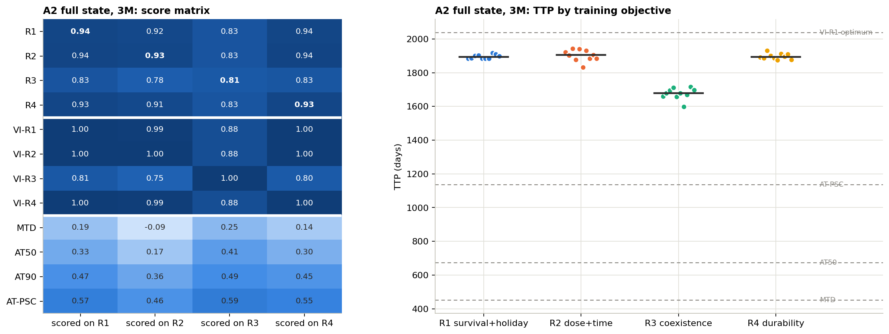
Full information, 3M steps: R3 still costs most
A2 · RESULTS (2 OF 3)
How to read it: left = every strategy on every goal; right = days per AI. Middles: R1 1893 · R2 1904 · R3 1678 · R4 1892. Own-goal scores 0.81–0.94.
Notes:
With more training the full-information goals actually drift further apart: R1 versus R3 went from 3.8 to 6.1 times the luck level. Training on R3 still costs about 15% on other goals.

Slide 80
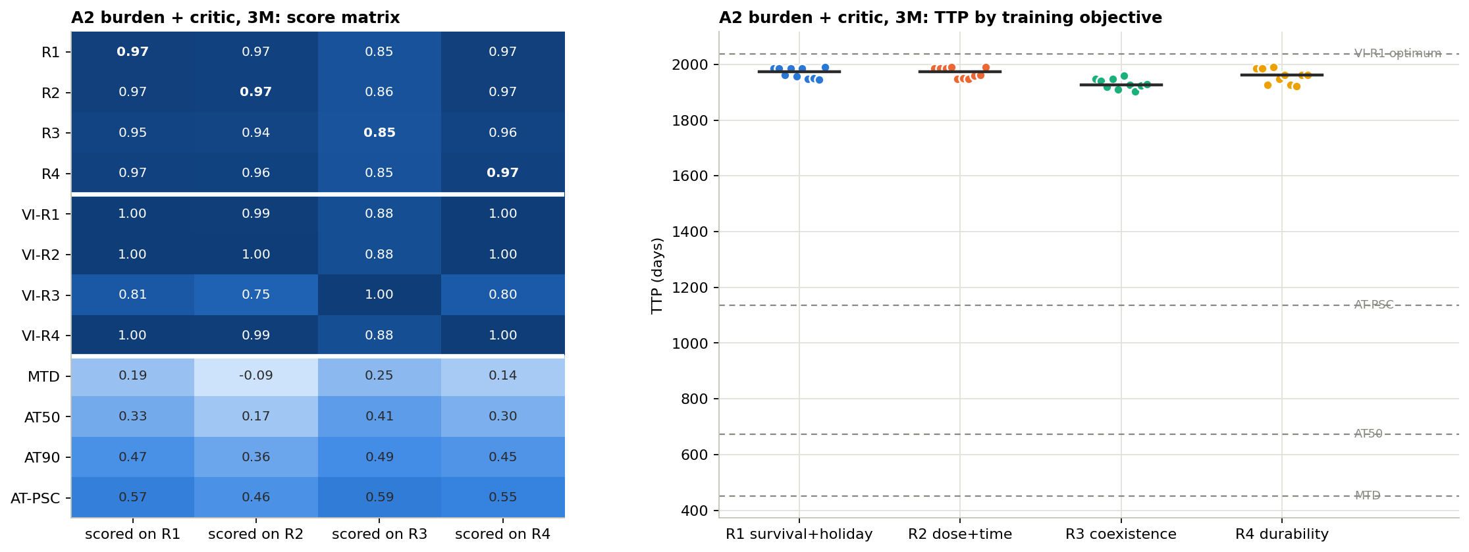
Size + better judge, 3M: goals almost identical
A2 · RESULTS (3 OF 3)
How to read it: as before. Middles: R1 1973 · R2 1974 · R3 1927 · R4 1962 days, the best AIs in the whole project, within 4% of the full-information best plan.
Notes:
Every goal beats its full-information counterpart at equal training (Mann–Whitney p = 0.0002 to 0.0004). Even R3, trained only on size, reaches 1927 days.

Slide 81
In a fair race, size + better judge wins
A2 · WHAT WE FOUND
1
Clear order at equal training: size + judge 0.97 > full information 0.94 > memory 0.92 of the best plan.
2
With full information the goals drift further apart; R3 still costs about 15%.
3
With size + judge the goals collapse: the worst wrong-goal cost is 2.3%.
4
Confirmed, not overturned: what the AI sees matters more than its goal.
Notes:
The scores in point 1 are measured on R1, the survival goal. The ordering held for every goal with p at or below 0.0004. This experiment turned the Part 4 result from “suggestive” into the strongest finding of the project.

Slide 82
Is our “best possible plan” precise enough?
A3 · METHOD
1
We doubled the grid in both directions: 161 × 241 → 321 × 481 squares.
THE QUESTION
The best plan is worked out on a grid. Would a finer grid change our yardstick?
2
We re-solved the best plan for all four goals.
3
We compared days to failure and the score range each goal uses.
4
Pass rule, set in advance: both must move by less than 1%.
Notes:
Every score in the project is a fraction of the best plan, so if the best plan were imprecise, every score would be too. A reviewer’s natural question is “your AIs trained badly, or your ceiling is wrong?”. This check answers the second half.

Slide 83
A 4× finer grid changes almost nothing
A3 · RESULTS
Goal | Normal grid | Fine grid | Change
R1 | 2038 days | 2038 days | 0%
R2 | 2030 days | 2030 days | 0%
R3 | 1625 days | 1625 days | 0%
R4 | 2038 days | 2030 days | −0.36%
Score range: changed by at most 0.02% for any goal.
How to read it: there is no graph for this check. R4’s small change comes from a near-tie with R1 that the finer grid breaks the other way.
Notes:
The score range is the gap between the best plan and no treatment for each goal; it is the denominator of every score. The planner needed between 4 and 14 rounds of improvement to settle for each goal on the fine grid.

Slide 84
Our yardstick is solid
A3 · WHAT WE FOUND
1
Days moved at most 0.36%; score ranges at most 0.02%.
2
Both are far inside the 1% rule we set before running it.
3
Every score in this deck is safe: the ceiling it is measured against is precise.
Notes:
A short experiment, but it protects every number in the project. If the AIs look 15% below the best plan, that gap is real and not an artefact of a coarse grid.

Slide 85
Survival versus drug: is anyone wasting drug?
B1 · METHOD
1
We placed every AI, best plan and human rule by drug used and days survived.
THE QUESTION
Some AIs survive less but use less drug. Is that a fair trade-off, or simply worse?
2
A strategy is “beaten” if another is better on both at once.
3
Two drug measures: total drug, and the share of time on drug.
4
A third chart: the share of resistant cells when treatment fails.
Notes:
The set of strategies that nobody beats on both measures is called the Pareto frontier. This experiment was prompted by the R2 memory AIs in E11c and E11d: they survive less but use less drug, which could be a sensible choice rather than a failure.

Slide 86
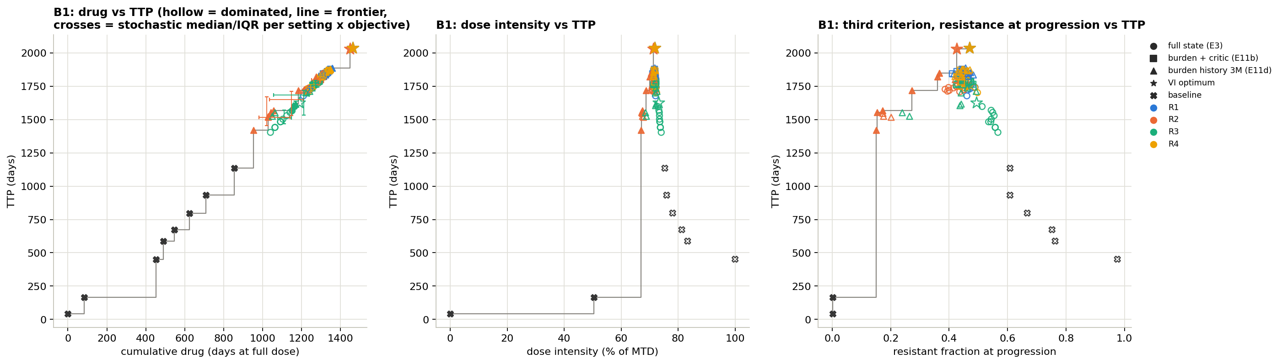
One line links drug use and survival
B1 · RESULTS
Left: total drug vs days. Middle: share of time on drug vs days. Right: resistant share at failure vs days. Hollow = beaten by another strategy; grey line = the frontier; × = human rules.
Notes:
Shapes show how the AI sees: circle = full information, square = size + better judge, triangle = size history. Colours show the goal. Stars are best plans. The stepped grey line connects the strategies that nobody beats.

Slide 87
Living longer costs drug, and that is fine
B1 · WHAT WE FOUND
1
Good strategies give drug about 72% of the time, so more days simply means more total drug.
2
Share of time on drug is the fair way to compare, not total drug.
3
R2’s memory AIs make a real trade-off: about 285 fewer days for 4 points less drug, and nobody beats them.
4
Most human rules are beaten: more drug and fewer days than the AIs.
Notes:
Point 3 changes how we described R2 in E11c and E11d. It is still not better at its own goal than a survival-trained AI, but it is not wasteful either: it sits on the frontier of drug versus survival. Whether that trade is worth it is a clinical choice, not a technical one.

Slide 88
Was R3 just badly designed?
B2 · METHOD
1
Smooth mix: points rise gradually as the mix moves toward 50:50.
THE QUESTION
R3’s reward is all-or-nothing around a 50:50 mix. Would a smoother reward do better?
2
Smooth target: most points at a chosen resistant share (5%, 10%, 25% or 50%).
3
We trained AIs for each version and solved its best plan.
4
We compared them with the original R3 and with survival-trained AIs.
Notes:
A smooth reward gives the AI feedback every week instead of only near the target, which usually makes learning easier. The penalty for failure and the size of the weekly reward were kept the same as R3 so the comparison is fair. 10 AIs for the smooth mix, 5 per target for the smooth target.

Slide 89
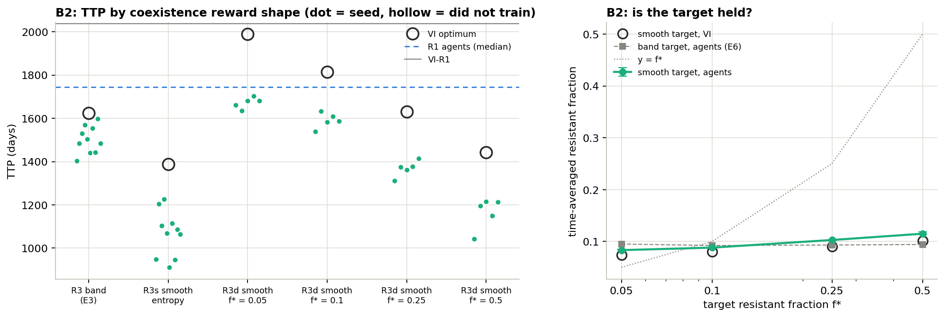
Smoother rewards don’t rescue R3
B2 · RESULTS
Left: days per AI (dots) and best plan (circles) for each reward shape; blue dashed = survival-trained AIs. Right: resistant share reached vs target; the dotted line is “hit the target”.
Notes:
Every coexistence reward, smooth or not, leaves the AI below survival-trained AIs. The smooth targets show a pattern: the closer the target is to the roughly 9% share that containment produces anyway, the cheaper it is. A 5% target costs only about 3%.

Slide 90
R3’s problem is the idea, not the details
B2 · WHAT WE FOUND
1
A smooth mix reward is even worse: best plan 1387 days vs 1625 for the original.
2
With a smooth target, the target matters: 5% is nearly free (1989 days), 50% is costly (1443).
3
Nobody holds the resistant share above about 12%, not even the best plan.
4
Survival-trained AIs still score higher on every mix reward than the mix-trained AIs.
Notes:
This backs up E6: the trouble with coexistence is structural, because a tumour that will progress cannot be held at a fixed mix. Rewording the reward cannot change that.

Slide 91
How often is the drug switched on and off?
B3 · METHOD
1
A switch = a week whose dose differs from the week before.
THE QUESTION
A schedule that flips every week is hard to follow in a clinic. How often do ours switch?
2
Counted for the best plans, the human rules and the AIs on our main patient.
3
Reported per year and as a share of all weekly decisions.
4
Rule set in advance: if the best plans switch on over 25% of weeks, run D4.
Notes:
This is a quick analysis on existing strategies, with no new training. It acts as a gate: D4, a more expensive experiment that penalises switching, is only worth running if switching turns out to be frequent.

Slide 92
Best plans and AIs switch about every other week
B3 · RESULTS
Strategy | Switches per year | Share of weeks
Best plan for R1, R2, R4 | 28 | 54%
Best plan for R3 | 23 | 44%
AIs (every goal, every setting) | 27–31 | 52–59%
On/off cycles (IT) | 11 | 22%
AT90 | 9 | 18%
AT-PSC, tuned | 6 | 12%
AT50 | 2 | 4%
Full dose / no treatment | 0 | 0%
How to read it: no graph for this analysis. Switches are counted along each patient’s actual path, from the start until failure.
Notes:
AIs here include all three ways of seeing: full information, size with the better judge, and size history at 3 million steps. They all switch at about the same rate as the best plans, because they learned the same pulsing containment pattern.

Slide 93
The best schedules are busy
B3 · WHAT WE FOUND
1
Best plans and AIs change the dose on about half of all weeks: 27–31 times a year.
2
Human rules switch far less: at most 22% of weeks.
3
Why: containment works by many short pulses that keep the tumour just under the line.
4
54% is above our 25% gate, so we ran D4 to see what fewer switches would cost.
Notes:
In a real clinic, every switch may mean a visit, a prescription change or a patient decision, so very busy schedules could be impractical. D4 measures how much benefit you give up for a calmer schedule.

Slide 94
What if “failure” is defined differently?
B4 · METHOD
1
We moved the failure line to 1.1, 1.2 and 1.3 × the starting size.
THE QUESTION
We call it failure at 20% growth. Would 10% or 30% change the conclusions?
2
For each, we re-solved the best plan for all four goals (no new AI training).
3
We compared the ranking of the goals and how much R3 loses.
4
Full dose and AT50 were recorded for reference.
Notes:
The 20% line comes from Gallagher et al., but it is a modelling choice; clinical definitions of progression vary. The failure line sets the whole control problem, because containment works by riding just under it.

Slide 95
Same ranking at every failure line
B4 · RESULTS
Failure line | Full dose | AT50 | R1 | R2 | R3 | R4 | R3 loses
1.1 × | 427 | 633 | 1176 | 1141 | 1015 | 1176 | 14%
1.2 × | 452 | 673 | 2038 | 2030 | 1625 | 2038 | 20%
1.3 × | 508 | 756 | 7812 | 7791 | 5741 | 7812 | 27%
How to read it: days to failure for full dose, AT50 and the best plan of each goal. 1.2 × is the line used everywhere else. No graph for this check.
Notes:
The jump to 7812 days at 1.3 times reflects how much more room a higher line gives the containment strategy before the resistant population alone can cross it. Human rules gain only a little from the extra room.

Slide 96
The line changes the numbers, not the story
B4 · WHAT WE FOUND
1
Same order at every line: R1 = R4, then R2, then R3.
2
R3 loses more as the line rises: 14% → 20% → 27%.
3
A higher line gives containment far more room: 7812 days at 1.3×.
4
Full dose barely moves (427–508 days): it cannot use the extra room.
Notes:
Point 3 also suggests something clinically relevant: how much tumour growth is tolerated before switching strategy matters a lot for containment. But that is a question about the patient, not about which goal to give the AI.

Slide 97
Does it hold across a whole map of patients?
C1 · METHOD
1
A 5 × 5 grid of patients: resistance cost 0–40% × natural cell death 0–4%.
THE QUESTION
Instead of a few patients, can we check the main findings over a whole range?
2
For each of the 25, we solved the best plan for all four goals.
3
Measured: do R1 and R4 act differently, and how much does R3 lose?
4
And: how often can R3 actually hold its target mix?
Notes:
This is the same patient box as the held-out patients in E7, and the kind of map Gallagher et al. drew. Only best plans are computed here; training AIs at 25 patients would be very expensive, and A1 already covers one corner of the map with AIs.

Slide 98
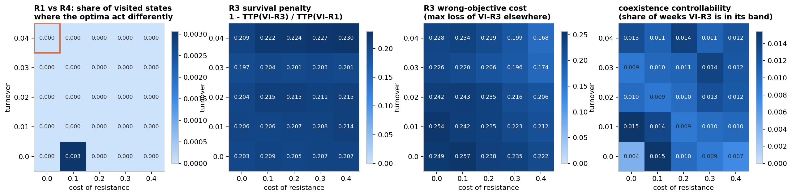
The same pattern at all 25 patients
C1 · RESULTS
How to read it: each panel is the 25-patient map (across = resistance cost, up = natural cell death). From left: where R1 and R4 differ · R3’s survival loss · R3’s cost on other goals · share of weeks R3 is at its target mix.
Notes:
The orange box in the first panel marks the A1 patient, where we also trained AIs. All 25 patients fail within the 30-year cap, so every best plan is valid. In the first panel only one patient shows any difference between R1 and R4, and it is 0.3% of situations.

Slide 99
From “a few patients” to “a whole region”
C1 · WHAT WE FOUND
1
R1 and R4 act the same at all 25 patients (they differ in at most 0.3% of situations).
2
R3 survives 20–23% less everywhere and costs 17–26% on the other goals.
3
R1, R2 and R4 cost each other at most 2%.
4
R3 holds its target mix at most 1.5% of the time, on every patient.
Notes:
This is the broadest check in the project. It turns the claim “R1 equals R4, and R3 comes last” from something seen on two or three patients into something that holds over the whole range of patients we consider realistic.

Slide 100
What if a half dose is allowed?
D1 · METHOD
1
Three choices each week: no drug, half dose, full dose.
THE QUESTION
So far the drug is all or nothing. Does a half dose help, and change which goal wins?
2
First we checked what each fixed dose does on its own.
3
Then: best plan per goal, and 10 AIs per goal with three doses.
4
R1’s drug-free bonus pays only at zero dose; we also tried a version paid in proportion to drug withheld (“R1p”).
Notes:
Our first round deliberately used only on/off doses, as in Gallagher. A half dose is a natural clinical option. Everything else about the AI is unchanged: it now picks one of three doses instead of two, with the same settings and training length.

Slide 101
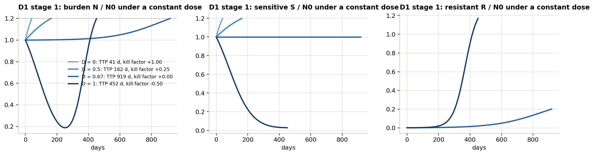
What a fixed dose does on its own
D1 · RESULTS (1 OF 4)
How to read it: left = whole tumour, middle = sensitive cells, right = resistant cells, each under one constant dose. Days to failure: no drug 41 · half dose 162 · 2/3 dose 919 · full dose 452.
Notes:
The 2/3 dose is special: it exactly balances sensitive-cell growth against the drug, so sensitive cells stay flat (middle panel) and keep competing with the resistant ones. As a constant dose it already lasts twice as long as full dose. A half dose alone is too weak and the tumour grows.

Slide 102
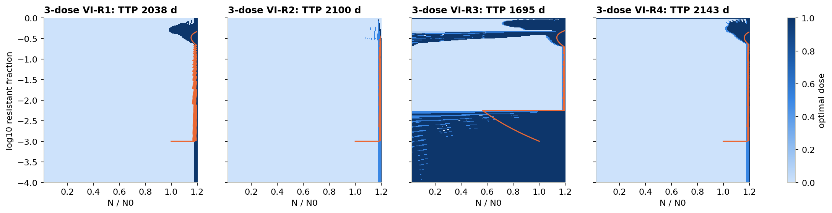
Best plans with three doses
D1 · RESULTS (2 OF 4)
How to read it: light = no drug, mid-blue = half dose, dark = full dose; orange line = the tumour’s path. Days: R1 2038 · R2 2100 · R3 1695 · R4 2143.
R1 never uses the half dose. R2, R3 and R4 use it on 43–55% of weeks.
Notes:
With two doses, R1 and R4 had identical best plans at 2038 days. With three, R4 jumps to 2143 while R1 stays at 2038, because R1 does not use the new option. The next slides show whether the AIs learn the same thing.

Slide 103
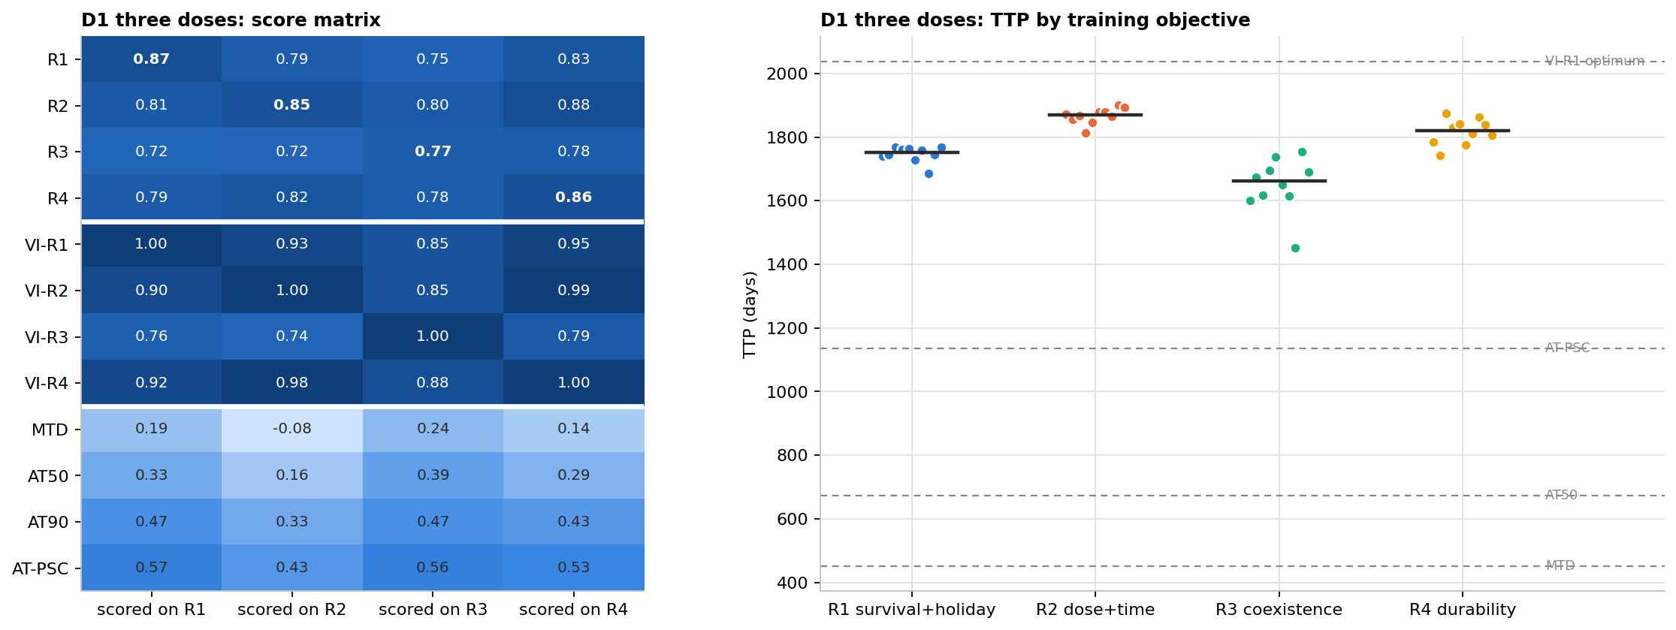
AIs with three doses: R1 now trails R2 and R4
D1 · RESULTS (3 OF 4)
How to read it: left = every strategy on every goal (as in E4); right = days per AI. Middles: R1 1752 · R2 1869 · R3 1661 · R4 1819 (two doses: 1744 · 1726 · 1494 · 1751).
Notes:
R3 is still the weakest goal, but the gap to R1 shrinks to about 90 days because R1 gains almost nothing from the half dose. Training on R3 still costs up to 15% elsewhere.

Slide 104
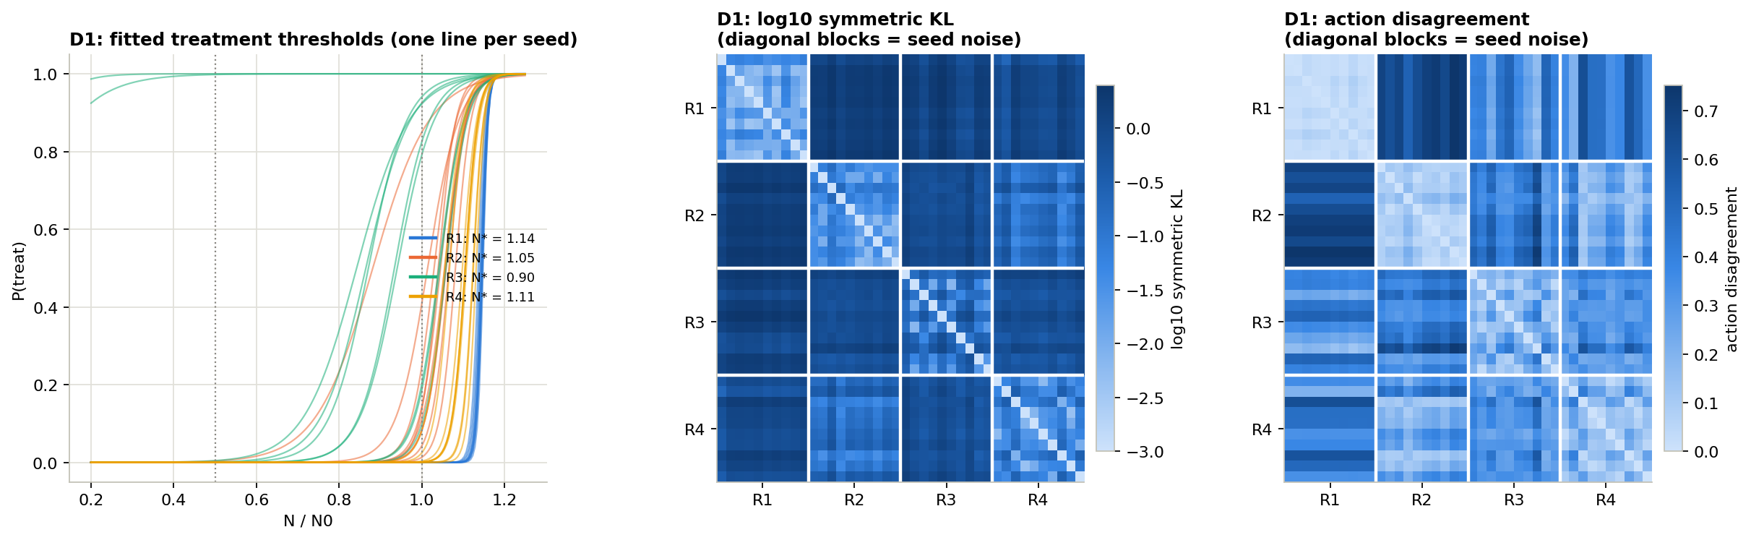
All six pairs of goals now differ
D1 · RESULTS (4 OF 4)
How to read it: left = when each AI gives any drug. Middle and right = differences between AIs; darker = more different, diagonal blocks = luck level. R1 vs R4 now differ 4× more than luck.
Notes:
With three doses, the comparisons use the full distribution over doses, and disagreement means picking a different most-likely dose. R1 versus R2 differs most, about 11 times the luck level, because R2 uses the half dose heavily and R1 never does.

Slide 105
Half doses help, and expose a detail in R1
D1 · WHAT WE FOUND
1
A half dose adds time: +70–105 days for the best plans of R2, R3, R4, and +68–168 days for their AIs.
2
R1 ignores it: its drug-free bonus only pays at zero dose, so R1 and R4 split (2038 vs 2143 days).
3
Fix the bonus and R1 = R4 returns: paid in proportion to drug withheld (R1p), it gives exactly R4’s plan.
4
AIs learn the half dose: R2, R3 and R4 AIs use it on about half of all weeks.
Notes:
So the one place where survival and lasting control seemed to split turned out to be a detail of how the original R1 reward was written, not a real difference between the goals. With two doses the detail never mattered, because the only options were all or nothing.

Slide 106
How many dose levels are worth having?
D2 · METHOD
1
Dose sets: 2 levels {0, 1}, 3 levels {0, ½, 1}, 5 levels {0, ¼, ½, ¾, 1}.
THE QUESTION
If a half dose helps, do more levels help more, for the planner and for the AI?
2
Plus {0, ⅔, 1}: ⅔ is the dose that exactly stops sensitive cells growing.
3
The best plan for every set and every goal.
4
10 AIs per goal with 5 levels, compared with the 2-level (E3) and 3-level (D1) AIs.
Notes:
The sets 2, 3 and 5 levels are nested: each contains the one before, so the best plan can only improve as levels are added. The {0, 2/3, 1} set is not nested, so it was solved by the planner only and not trained.

Slide 107
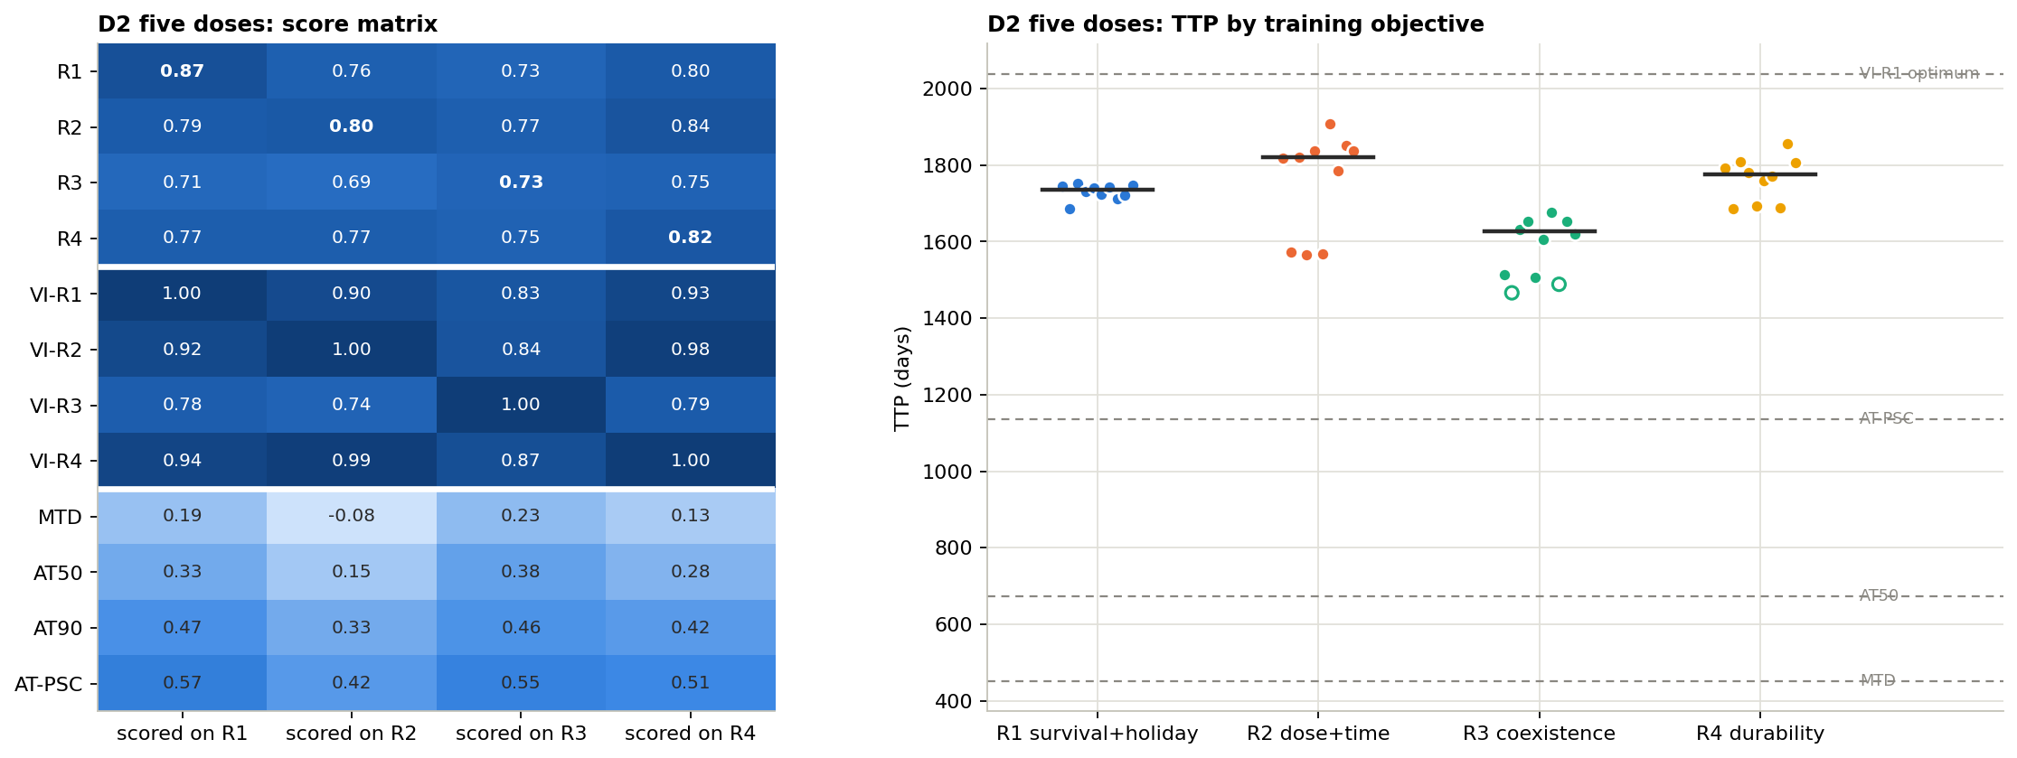
The planner gains from levels; the AI does not
D2 · RESULTS
Best plan, days | R2 | R3 | R4
2 levels | 2030 | 1625 | 2038
{0, ½, 1} | 2100 | 1695 | 2143
{0, ⅔, 1} | 2142 | 1724 | 2185
5 levels | 2135 | 1737 | 2205
AI score | R1 | R2 | R3 | R4
2 levels | 0.87 | 0.85 | 0.76 | 0.87
3 levels | 0.87 | 0.85 | 0.77 | 0.86
5 levels | 0.87 | 0.80 | 0.73 | 0.82
5-level AIs: every strategy on every goal, and days per AI (R1 1735 · R2 1820 · R3 1626 · R4 1776).
How to read it: top table = days for the best plan (R1 stays at 2038 throughout). Bottom table = each AI’s score on its own goal; with 5 levels, 2 of 10 R3 AIs did not train.
Notes:
Scores are relative to each set’s own best plan, so a lower score at 5 levels means the AI is further from what is possible with 5 levels, even if its days are similar. The 2/3 set beats 5 levels for R2 because 2/3 is exactly the dose that freezes sensitive growth.

Slide 108
More levels help the planner, not the AI
D2 · WHAT WE FOUND
1
The best plan keeps improving with more levels (R4: 2038 → 2143 → 2205 days).
2
The AIs get worse from 3 to 5 levels (R2 0.85 → 0.80): more choices are harder to learn.
3
One smart middle dose is enough: ⅔ gets most of the gain, and beats 5 levels for R2.
4
R1 still almost never uses a middle dose, at any number of levels.
Notes:
For a clinic, this suggests offering one well-chosen intermediate dose rather than many. Training an AI on the {0, 2/3, 1} set is one of our recommended next steps.

Slide 109
Does it matter how strong a half dose is?
D3 · METHOD
1
Three shapes: a half dose gives 71%, 50% or 25% of the full effect.
THE QUESTION
We assumed half the dose gives half the effect. What if real drugs don’t work that way?
2
No drug and full dose behave exactly as before, so the comparison is fair.
3
We re-solved the three-dose best plan for each shape and goal.
4
We measured the gain from the half dose and how often it is used.
Notes:
The effect is modelled as dose to the power h, with h = 0.5 (saturating, 71% at half dose), h = 1 (linear, 50%) and h = 2 (threshold-like, 25%). This is a sensitivity check, not a calibrated model of a specific drug, so it was done with the planner only.

Slide 110
A weaker half dose gives a smaller gain
D3 · RESULTS
Half dose gives | R2 | R3 | R4 | R4 gain | R4 half-dose weeks
71% of full effect | 2058 | 1709 | 2150 | +112 | 74%
50% (our default) | 2100 | 1695 | 2143 | +105 | 53%
25% of full effect | 1995 | 1660 | 2094 | +56 | 20%
How to read it: days to failure for the three-dose best plan. “R4 gain” is compared with on/off only (2038 days). R1 stays at 2038 for every shape. No graph for this check.
Notes:
R2 can end up with fewer days than with on/off dosing when the half dose is weak, because R2 also values saving drug and trades some survival for it. The direction of the half-dose benefit for R4 is the same for every shape; only the size changes.

Slide 111
The drug’s curve sets the size, not the direction
D3 · WHAT WE FOUND
1
The half dose always helps R4, by 56 to 112 days depending on the drug’s curve.
2
A weaker half dose is used less: 74% → 53% → 20% of weeks.
3
Graded-dose numbers depend on the drug, so D1 and D2 results should be read with that caveat.
Notes:
Any real drug would need its own dose–response curve measured before graded dosing could be planned. The qualitative result, that an intermediate dose helps containment, is robust; the exact number of extra days is not.

Slide 112
What does a calmer schedule cost?
D4 · METHOD
1
A small penalty each time the dose changes, in 5 sizes from 0 to 0.1 (one week of survival is worth 0.1).
THE QUESTION
Best plans switch almost every other week. What do we lose if switching is discouraged?
2
The planner now remembers last week’s dose so it can count switches.
3
We re-solved each goal’s best plan, with 2 and with 3 doses.
4
Each calmer plan was judged on the original goal, without the penalty.
Notes:
This experiment ran because B3 found switching on 54% of weeks, above the 25% gate. It was done with the planner only; teaching an AI to avoid switches would need it to see last week’s dose, which is a recommended next step.

Slide 113
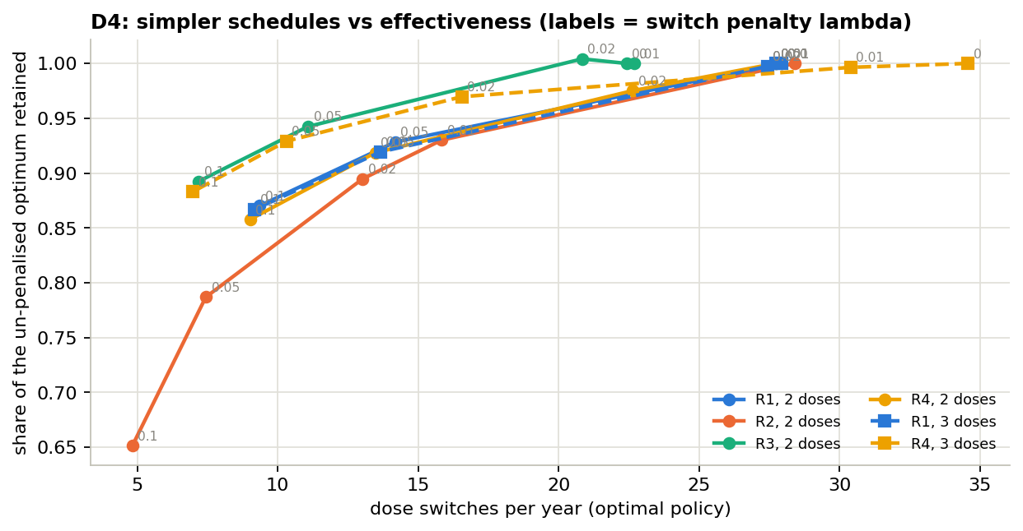
Fewer switches cost surprisingly little
D4 · RESULTS
R1, 2 DOSES
No penalty: 28 switches a year, 2038 days
Medium: 14 a year, 1880 days, 93% kept
Strong: 9 a year, 1755 days, 87% kept
How to read it: each line is one goal; each dot one penalty size (grey labels). Across = switches per year; up = share of the original best plan’s benefit kept. Top right = no penalty.
Notes:
Dashed lines are the three-dose versions for R1 and R4. With three doses, R4 starts higher (35 switches a year, 2143 days) and still keeps 88% at 7 switches a year. R2 is the most sensitive, because its goal already balances drug against time very finely.

Slide 114
Clinic-friendly schedules are cheap
D4 · WHAT WE FOUND
1
Halving the switches keeps 92–94% of the benefit for R1, R3 and R4.
2
At about 9 switches a year, R1’s plan still lasts 1755 days, 55% longer than the best human rule.
3
R2 pays most for calm: at 5 switches a year it keeps only 65%.
4
Simple, followable schedules exist that keep most of the gain.
Notes:
The best human rule, AT-PSC, switches about 6 times a year and lasts 1135 days. A calmer optimal plan at 9 switches a year lasts 1755 days, so the advantage of planning survives even when the schedule is made simple enough for a clinic.

Slide 115
What if sensitive cells can turn resistant?
FE1 · METHOD
1
Every day a tiny share of sensitive cells turns resistant (mutation rate μ).
THE QUESTION
With ongoing mutation, does “lasting control” finally differ from survival?
2
A rule set in advance picked μ: the smallest rate where R4’s best plan departs from R1’s. That was 3 per 100,000 cells per day.
3
At that rate: 10 AIs per goal, cross-scoring and strategy comparison.
4
Everything else is unchanged from our main patient.
Notes:
In the first round we argued that durability can only differ from survival if something makes a large sensitive population costly. Mutation does exactly that: more sensitive cells means more new resistant ones. This is the project’s “FE1”; in the code it is called E1 of the follow-up round. Higher rates make every patient fail very quickly (897 days at 10 per 100,000).

Slide 116
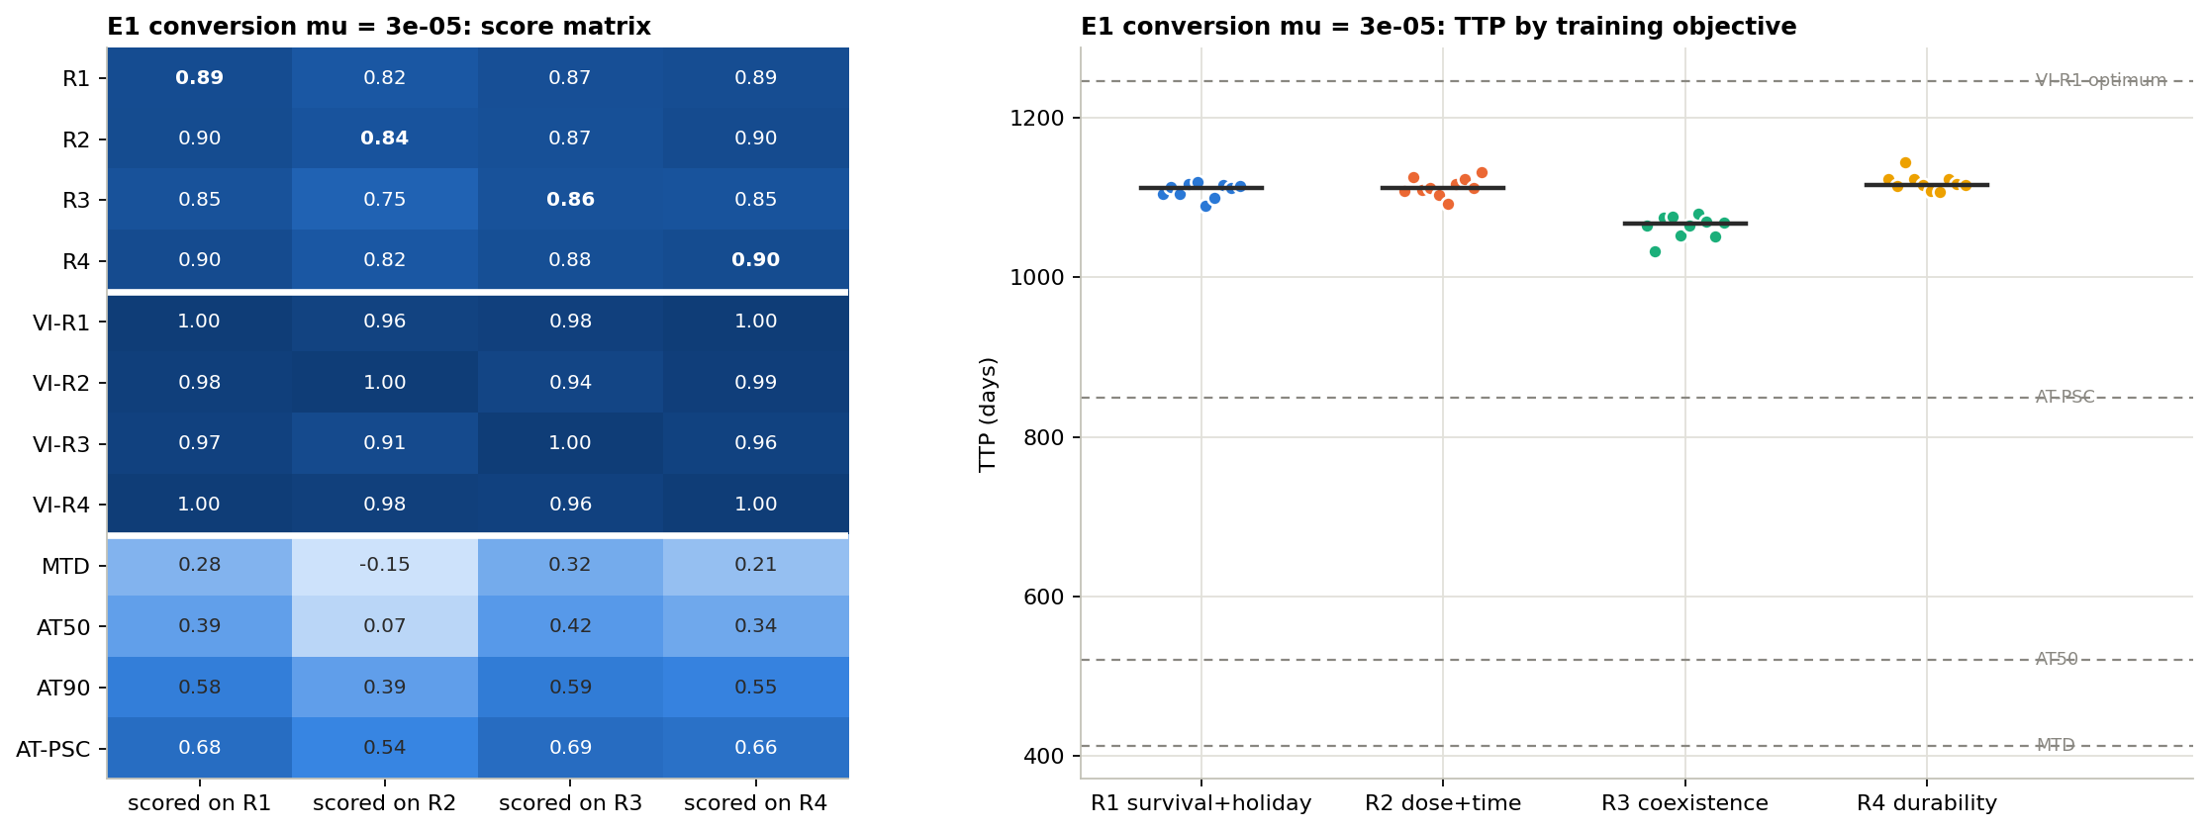
Mutation shortens survival for everyone
FE1 · RESULTS (1 OF 2)
How to read it: left = every strategy on every goal; right = days per AI. Middles: R1 1112 · R2 1112 · R3 1067 · R4 1116. Best plans: R1 1246, R4 1240. Without mutation: 1744–1751.
Notes:
All 40 AIs trained, with scores of 0.84 to 0.90 on their own goal. The largest cost of picking the wrong goal is 9%, lower than without mutation, because every strategy fails sooner and there is less room to differ.

Slide 117
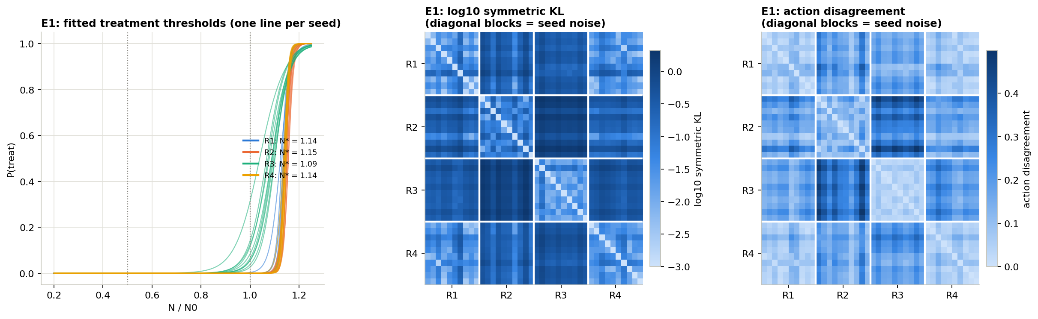
The AIs still can’t tell R1 and R4 apart
FE1 · RESULTS (2 OF 2)
How to read it: left = when each AI treats (thresholds R1 1.14, R2 1.15, R3 1.09, R4 1.14). Middle and right = differences between AIs; R1 vs R4 sits at the luck level (ratio 1.04, p = 0.18).
Notes:
Five of six goal pairs differ as before. The best-plan difference between R1 and R4 at this mutation rate is real but small: a 0.8 percentage-point difference in drug use and a few days of survival, which is below what ten trained AIs can resolve.

Slide 118
Mutation splits R1 and R4, but only on paper
FE1 · WHAT WE FOUND
1
R4’s best plan leaves fewer resistant cells after a break than R1’s (44% vs 49%), for 6 fewer days.
2
It is the project’s first real difference between lasting control and survival.
3
But it is small, and trained AIs cannot detect it (p = 0.18).
4
Everyone fails sooner, so the gap between goals shrinks (R1–R3: 45 days).
Notes:
So the route we predicted to make durability different from survival does exist, but at a mutation rate that still lets patients live for years it is weak. A stronger split would need a mechanism that punishes large sensitive populations more strongly, such as drug toxicity.

Slide 119
What if resistant cells are only partly resistant?
FE2 · METHOD
1
Resistant cells now feel a share ε of the drug, from 0 (none) to 0.5 (half).
THE QUESTION
If the drug also slowed resistant cells, could R3 finally hold its mix?
2
Run on our main patient and on the turnover patient from A1.
3
Best plan for every goal and every ε (no AI training).
4
We tracked R3’s loss, and whether the patient still fails within 30 years.
Notes:
Our plan claimed that partial sensitivity would let the drug reverse resistant growth. Working it through showed that is only true when cells also die naturally: without turnover, the drug slows resistant cells but never shrinks them. That is why we also ran the turnover patient. This is the project’s follow-up “E2”.

Slide 120
R3 loses about 20%, whatever ε is
FE2 · RESULTS
ε | Main: R1 | Main: R3 | R3 loses | Turnover: R1 | Turnover: R3 | R3 loses
0 | 2038 | 1625 | 20% | 3389 | 2682 | 21%
0.1 | 2310 | 1841 | 20% | 3892 | 3067 | 21%
0.2 | 2668 | 2136 | 20% | 4571 | 3627 | 21%
0.3 | 3151 | 2534 | 20% | 5558 | 4494 | 19%
0.4 | 3836 | 3101 | 19% | never fails | never fails | —
0.5 | 4886 | 3983 | 18% | never fails | never fails | —
How to read it: days to failure for the best R1 and R3 plans. “Never fails” = no failure within the 30-year limit. ε = how much of the drug resistant cells feel. No graph for this check.
Notes:
On the turnover patient at ε of 0.4 or more, a full dose shrinks resistant cells near the failure line, so the tumour can be held forever. At that point every goal reaches the 30-year limit and there is nothing left to compare.

Slide 121
Partial resistance doesn’t rescue R3
FE2 · WHAT WE FOUND
1
It helps everyone: survival rises 2.4× on our main patient at ε = 0.5.
2
R3 still loses 18–21% at every ε where the patient can fail.
3
When ε is big enough, the problem vanishes instead: the tumour can be held forever.
4
A correction to our plan: the drug only shrinks resistant cells if cells also die naturally.
Notes:
This is the last of the R3 checks. Across E6, B2, C1 and FE2, coexistence never wins while the patient can still progress. Making it possible to hold a mix also makes the patient controllable, at which point no goal is needed to choose between.

Slide 122
What we found, across all 30 experiments
CONCLUSION
1
Most goals lead to containment
2
“Keep the mix” is the costly mistake
Survival, less drug and lasting control all keep the tumour just under the line. R1 = R4 almost everywhere.
R3 does 12–23% worse in every patient and every stress test.
3
AI beats every human rule
4
What it sees beats what it aims for
About 50% longer than the best rule, and sturdier than the exact best plan thanks to a safety margin.
Seeing only tumour size, with a better judge in training, every goal does as well or better, and the goals nearly merge.
Notes:
These four points summarise the whole project. Point 1 comes from E2, E5, E3c, A1, C1 and B4, with D1 and FE1 as the only small exceptions. Point 2 from E4, E6 to E10, A1, B2, C1 and FE2. Point 3 from E1, E3, E4 and E8. Point 4 from E11 to E11d and A2.

Slide 123
What this could mean for treatment
CONCLUSION · FOR MEDICINE
1
Treat-when-needed containment beat the trial rule AT50 by a wide margin in every simulated patient.
2
A simple size threshold (treat above about 1.15–1.17 × the starting size) captures most of the benefit.
3
Monitor at least as often as a strategy was designed for; fewer check-ups can be dangerous.
4
Calmer schedules and one middle dose (about 9 switches a year, a ⅔ dose) keep most of the gain.
Important: all of this is in computer simulation. None of it has been tested in patients.
Notes:
These are hypotheses that the simulations support, not recommendations. Each would need testing against real patient data, for example the prostate-cancer datasets used to fit these models, before anyone could consider it clinically.

Slide 124
What this study cannot claim
CONCLUSION · LIMITS
Computer model only
Two well-mixed cell types; no tumour shape, blood drug levels or cells changing type (except FE1).
Few fully tested patients
Three patients with trained AIs; 25 more with best plans only.
An all-seeing AI in most tests
Most comparisons let the AI see the cell mix, which doctors cannot.
Our versions of the goals
R1–R4 are our adaptations of the original papers’ rewards.
No clinical claim
Adaptive therapy itself is still being tested in patients (Mistry 2021).
Notes:
Two smaller caveats: the best plan is computed on a grid (A3 showed this is precise to under 0.4%), and we used one learning method, PPO, throughout. Longer patients were harder to train at a fixed budget, which mainly affected R3.

Slide 125
What we would do next
CONCLUSION · NEXT STEPS
Noisy or late readings
AIs with a ⅔ dose
Real tumour markers are imprecise and delayed. Since what the AI sees matters most, test that next.
The planner gained most from this one dose; can a trained AI learn to use it?
AIs that remember last week’s dose
A side-effects goal
So they can learn calmer schedules themselves, as the planner did in D4.
Drug toxicity could make lasting control truly differ from survival.
Notes:
Noisy readings are the most relevant next step because the follow-up round made the observation, not the goal, the strongest lever in the study. A toxicity goal (Gevertz 2026 proposed one) would add a third state to the model.

Slide 126
Containment wins, and what the doctor can see decides how much the AI’s goal matters.
IN ONE SENTENCE
Thank you · Questions
Notes:
If asked for one takeaway: in this tumour model, survival, drug-saving and lasting-control goals all lead an AI to the same containment strategy; aiming for a balanced mix of cells is the one costly mistake; and once the AI only sees what a clinician sees, the choice of goal hardly matters, provided it is trained with a better judge.

